Slide 1

WiFi: IHG free
Choose Access Code
Password: clubs
To follow along, login on a separate PC or tablet https://prod.ebos.qsrsoft.com

Slide 2
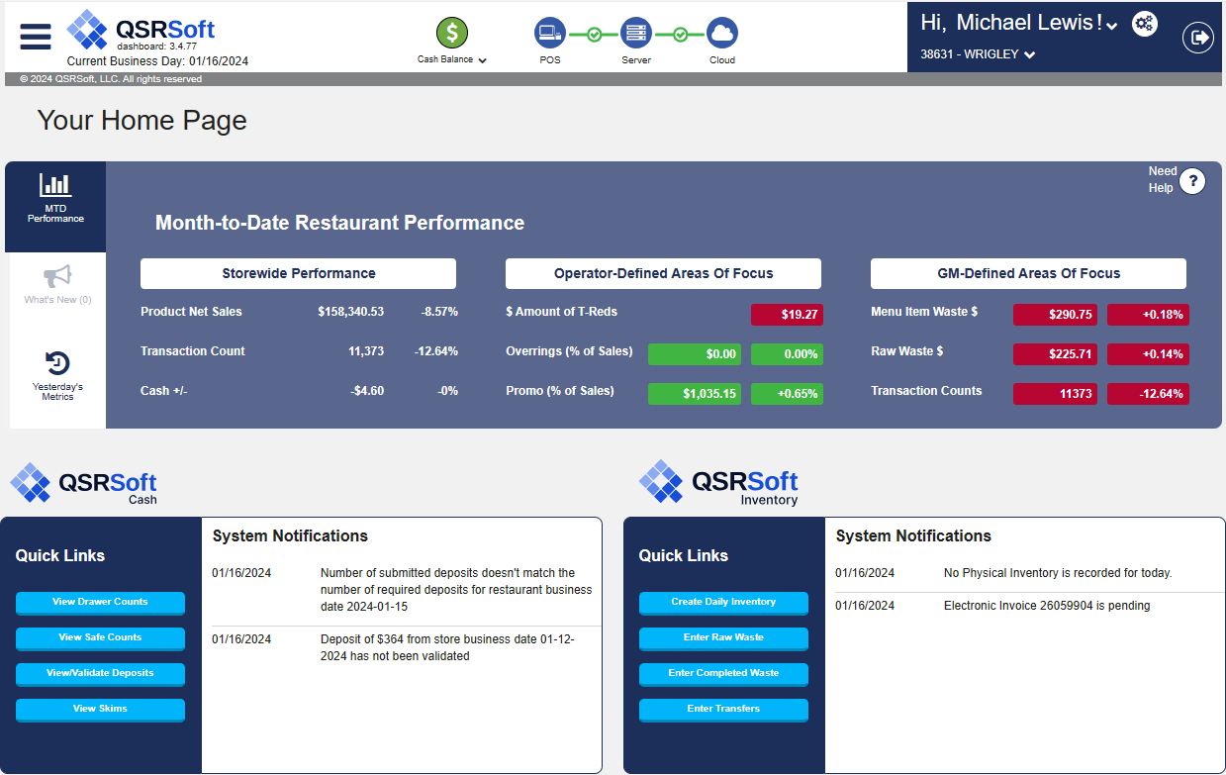
QsrSoft Inventory
Routines
Best Practices
Accountability
QSRSoft Inventory
Routines
Best Practices
Accountability
Notes:
Welcome
When we talk about QsrSoft Inventory Managers say, “I can’t fix it”, and that is not true. We will cover how to find it, and fix it, maybe even fixing some while in class.
Improving food costs is not about the tool, it is about using the accurate information on the floor. We will cover ways to improve on accuracy, it will be up to the organization to follow-up and accountability.
I expect each of you to walk away with a personal action item list.

Slide 3
Welcome
&
Agenda
Objectives
Training tools
Perpetual Inventory
Routines
  Waste, Transfers, Purchases
Inventory
  How & when
  Maintenance
Stat Loss
  Using sort to solve
  Raw Item Activity to validate
End-of-Month
FOB starting point
  Targets; setting and follow-up
  P&L side
  Controllable side
Accountability & Execution
  Blend of floor management & routines
Notes:
Let’s go over the agenda for today.
While we are training today, it’s important to understand where the current Existing training tools are located.
We will discuss timing & perpetual inventory. This is key as you will likely see some routines that will need to change.
Speaking of that we will cover Routines and best practices for Waste, Transfers, and Purchases
Then we will stop and talk about Inventory, there are major changes to this functionality from the way it was done with the ISP. If you have not changed your process, you are not taking advantage of the new system.
We will discuss How & when to take inventory and what kind of Maintenance needs to be completed regularly.
Next we will cover Stat Loss and using the ability to sort to solve an issue as well as using Raw Item Activity to validate the actions of the managers.
We will begin the wrap up by going over FOB. Normally it is your starting point for all things food cost. We will discuss Targets; setting and follow-up as well as the two sides of the FOB , the P&L side and the Controllable side
Last we will recap how you can use the system to create Accountability and improve on your Execution. It is a Blend of floor management & routines with the technology.
Questions & Wrap up

Slide 4

Pop Quiz!
”What equals one?”
Notes:
So, surprise! Let’s get started with a pop-quiz. This is something I have used over the years to make sure all my managers were in alignment, Please get out a sheet of paper and get ready.

Slide 5
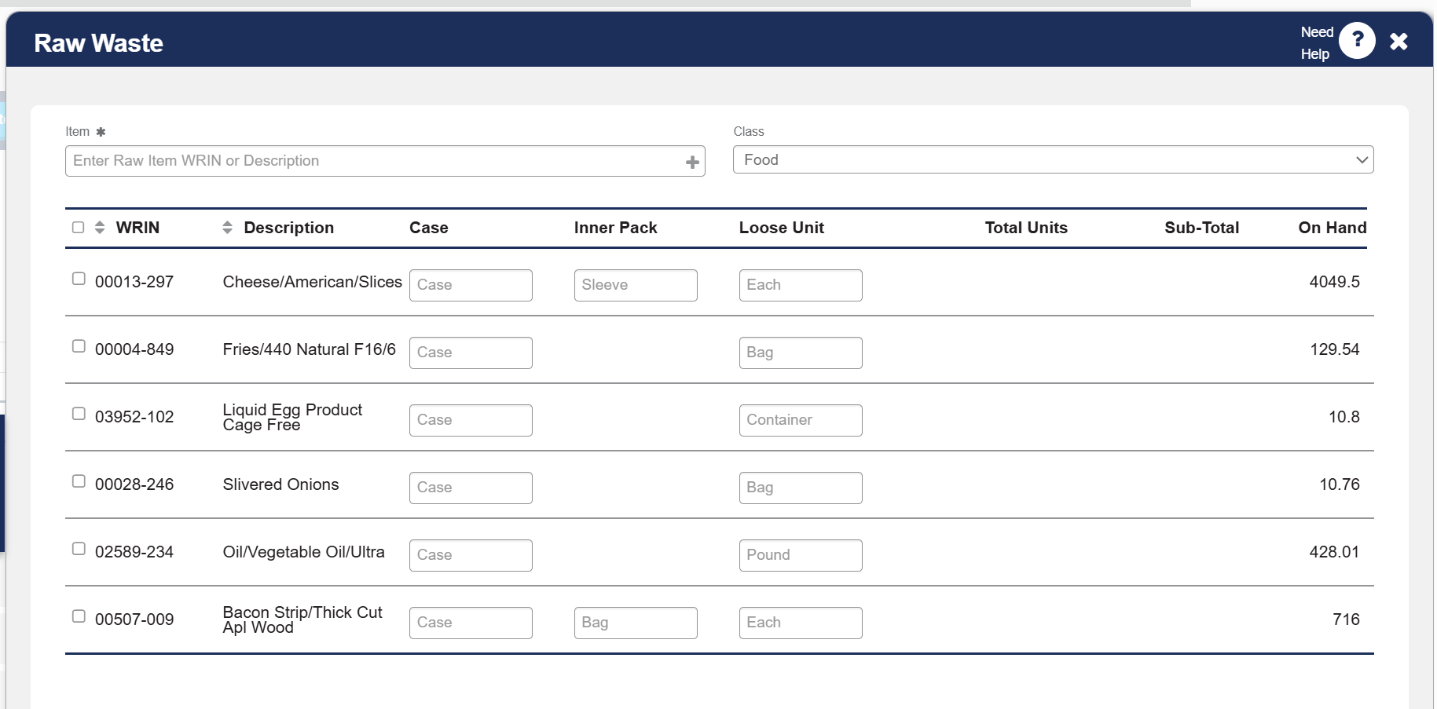
Notes:
So this is the raw waste screen, but this also applies to inventory. If you were about to waste “1” cheese, what does it mean? How do you count these items? The point is what does the system list as the Unit Of Measure to be, and are use using that measurement?
Instructor: For those who might not be able to see the screen, read each one. After you have finished the list, when you are ready, {CLICKING} will reveal the UOM name.
Question: What happens if you inventory 36 lbs. of fries on Monday night by typing 36 and the Tuesday night manager enters 6 bags?
Answer: Allowing for “normal” usage they will show up being short about 30 bags. You told the system you had 36 BAGS and they had 6 at close equals a loss of 30. They will be looking for product that did not exist.
As a supervisor, I want to know that the team is working on accuracy of the counts, such that I can have confidence in the reported numbers.

Slide 6
Questions?

Slide 7
Transition Kit or TKIT
https://mcdtkit.com
Notes:
So while we have this class today, let’s look at the materials that you will always have for you and your future managers.
The TKIT provided by McDonald’s as the transition from the ISP to the new Cash, Inventory and Timekeeping modules.
The Demo Walkthrough is designed to be viewed on a laptop or desktop computer. It’s self-guided and allows managers to click through functionality based on specific tasks they might be responsible for in their role.
The Transition Kit and Learn As You Go (LAYGO) are designed to be responsive and can be viewed on any smart device or computer, however the Transition Kit has a lot of text and you might find that it’s easier to view on a laptop or desktop.
As mentioned, Learn as You Go or LAYGO was designed to be readily accessible via smart device to provide on-the-job support after restaurants go live on CIT. For managers who don’t wish to pin the URL to the home screen of their phone, LAYGO can be accessed via the BOS Server or Fred tablet.

Slide 8
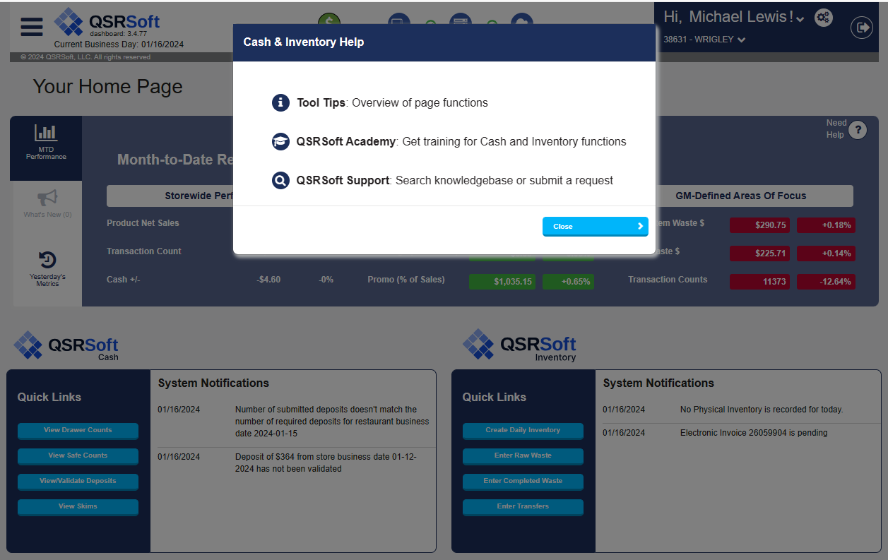
QsrSoft Academy
Click Need Help
Notes:
QsrSoft has the QsrSoft Academy. The link is available from any screen in Cash & Inventory with the Need Help button.
When you click on Need Help a window will appear asking if you want the Tool Tip, Academy or to reach the support team.
The tool tip is a quick reference based on the screen you are looking at, it describes the functionality and messages you might see, but it doesn’t tell you “how to”.
Academy is a set of “how to” video’s and job aide documents.
We will come back to to the support option in a minute

Slide 9

QsrSoft Academy
Scroll Down or CC for Spanish
CHAT
7am-7pm
Notes:
QsrSoft has the QsrSoft Academy. This is what you see when you open the link.
At the top, Use the search window to find content both video based as well as various job aide knowledge articles.
All of the QsrSoft tools are listed and all have content available. Find an example and use one of these at your next manager meeting.
The Spanish content if available will be located at the bottom of an article, or as subtitles in the video’s
Pick a topic, any topic, and use a video at your next manager meeting to facilitate continuous learning and discussion.

Slide 10
Questions?

Slide 11
What is the biggest challenge?
Physical Inventory is automatically updated on the fly based on inventory, waste, purchases or transfers
Managers can’t add or change inventory, waste, purchases or transfers in the past
How can we setup processes to manage these timing changes?
Notes:
So in the QsrSoft Inventory tool the biggest change is all about timing. All of the inventory tools involve automatic updates done on a timely basis. Managers can’t use this tool to make changes in the past, but why were you trying to edit the past anyway? What changes to routines can we make to work within the tool we have? ISP always worked in the past, QsrSoft inventory works from today forward. That means you have to have good processes in place.

Slide 12
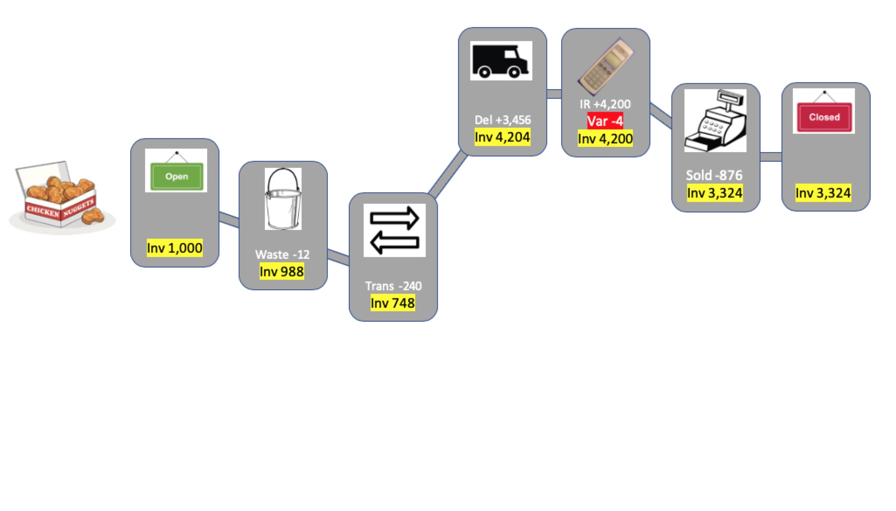
Perpetual Inventory
The story of the Chicken Nuggets
Notes:
Perpetual inventory is the heart of this timing, It is always going on behind the scenes. If I open with 1,000 nuggets and I waste 12, then transfer 240 (10 bags), then get my truck with another 3,456 (4 cases) I should have 4,204 nuggets.

Slide 13
Perpetual Inventory
Inv. @ 10am
Perpetual says 4,204 nuggets after truck.
Inventory of 4,200 means -4 stat variance
Taking an inventory at 10 am before nugget usage starts.
Notes:
If I complete a nugget inventory at 10am, before I have any sales yet, that is what my inventory should be. Let’s say I inventoried 4,200 that would mean I was -4.
But what if I forgot to enter my waste and my transfer and my purchase. Then how do I explain my 4,200 nuggets.

Slide 14
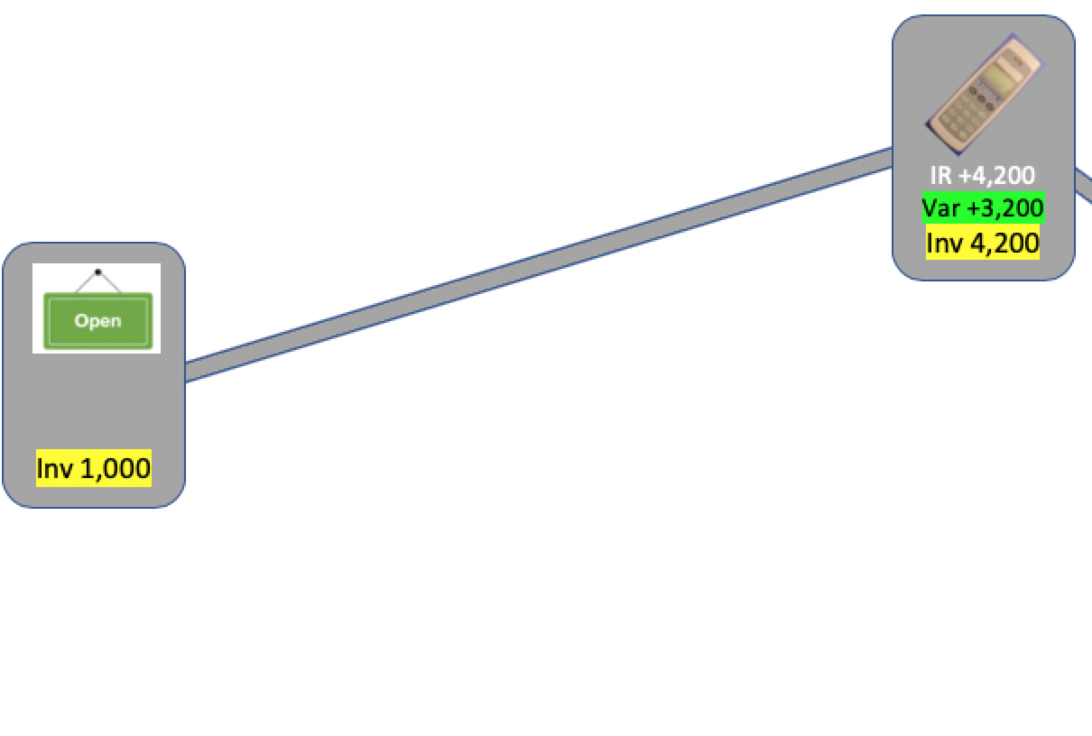
Perpetual Inventory
Plus 3,200 nuggets (grown)
Inventory taken without waste,
transfer and truck, will create a positive stat or potentially a negative actual usage
Perpetual says 4,204 nuggets after truck.
Inventory of 4,200 means -4 stat variance
Completing inventory before finishing waste, transfers, purchases will create errors
Notes:
But what if I forgot to enter my waste and my transfer and my purchase. Then how do I explain my 4,200 nuggets.
{Instructor, CLICK for scenario change}
In that case I will be plus 3,200 nuggets since I started with 1,000 and now have 4,200, so they “grew” from no where in the restaurant.

Slide 15
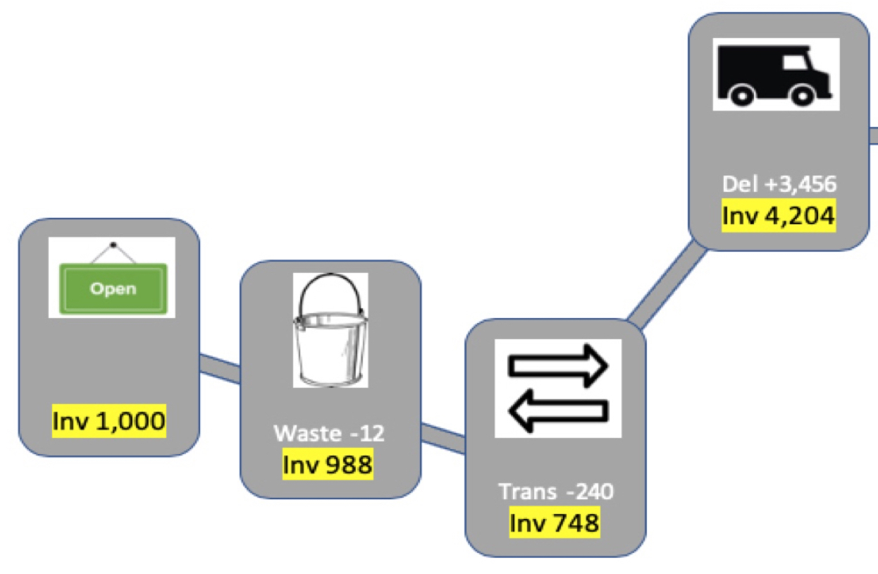
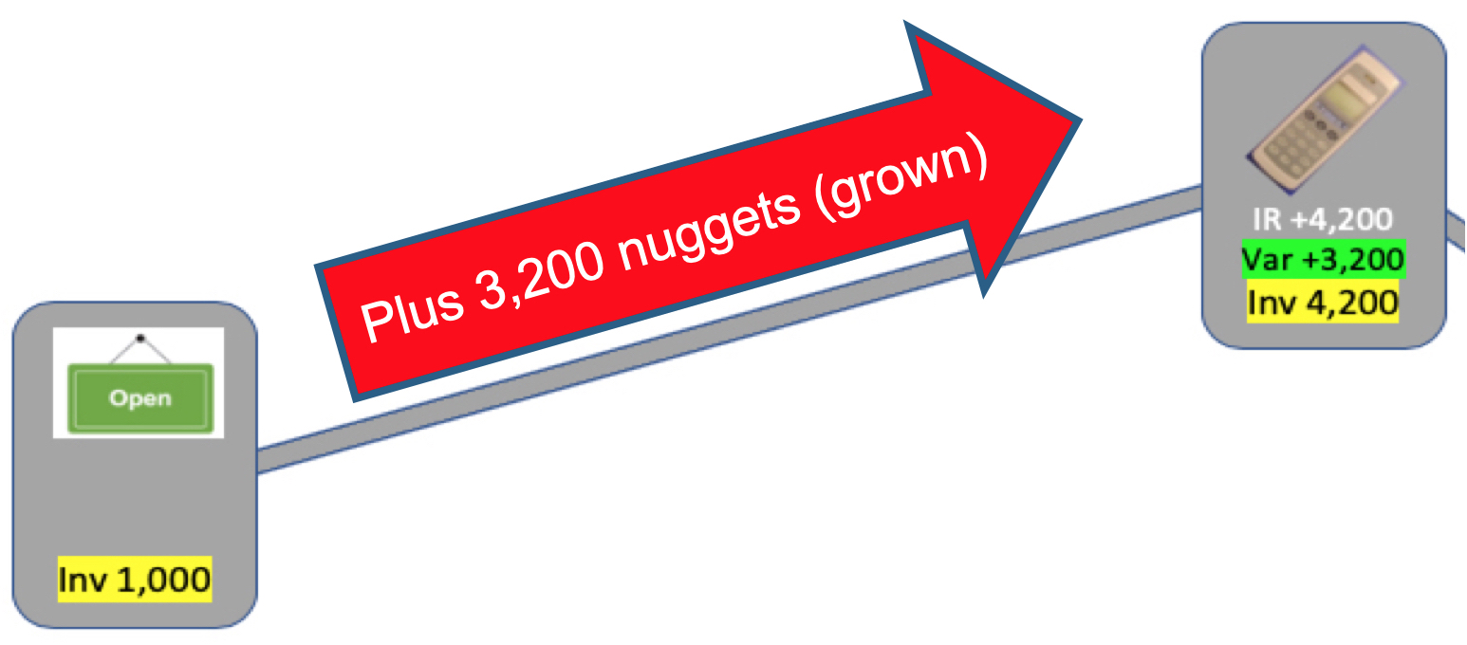
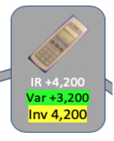
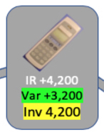
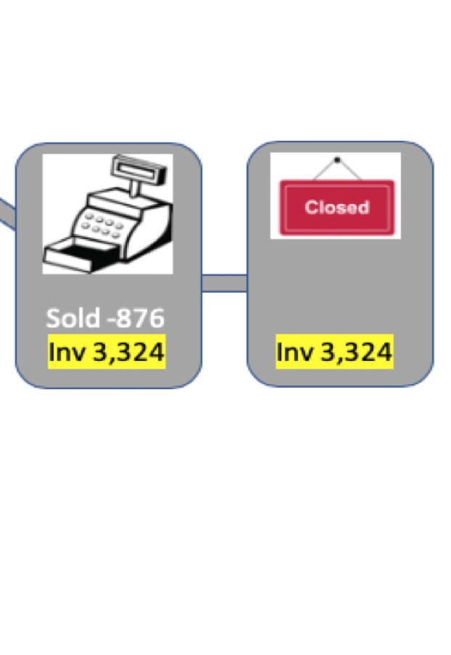
Perpetual Inventory
Minus 3,200
Inv. @ 10am
Inventory taken without waste,
transfer and truck, will create a positive stat or potentially a negative actual usage
Completing inventory before finishing waste, transfers, purchases will create errors
Notes:
To fix the issue, I need to get my waste and transfers entered and approve my delivery, then take another inventory, even if it is the same number, 4,200 as before to correct the issue. Now that is a lot of work, lets plan for how we can keep this information up to date.
Lets talk about waste, transfers and purchases and how we can plan to accurately record those events.

Slide 16
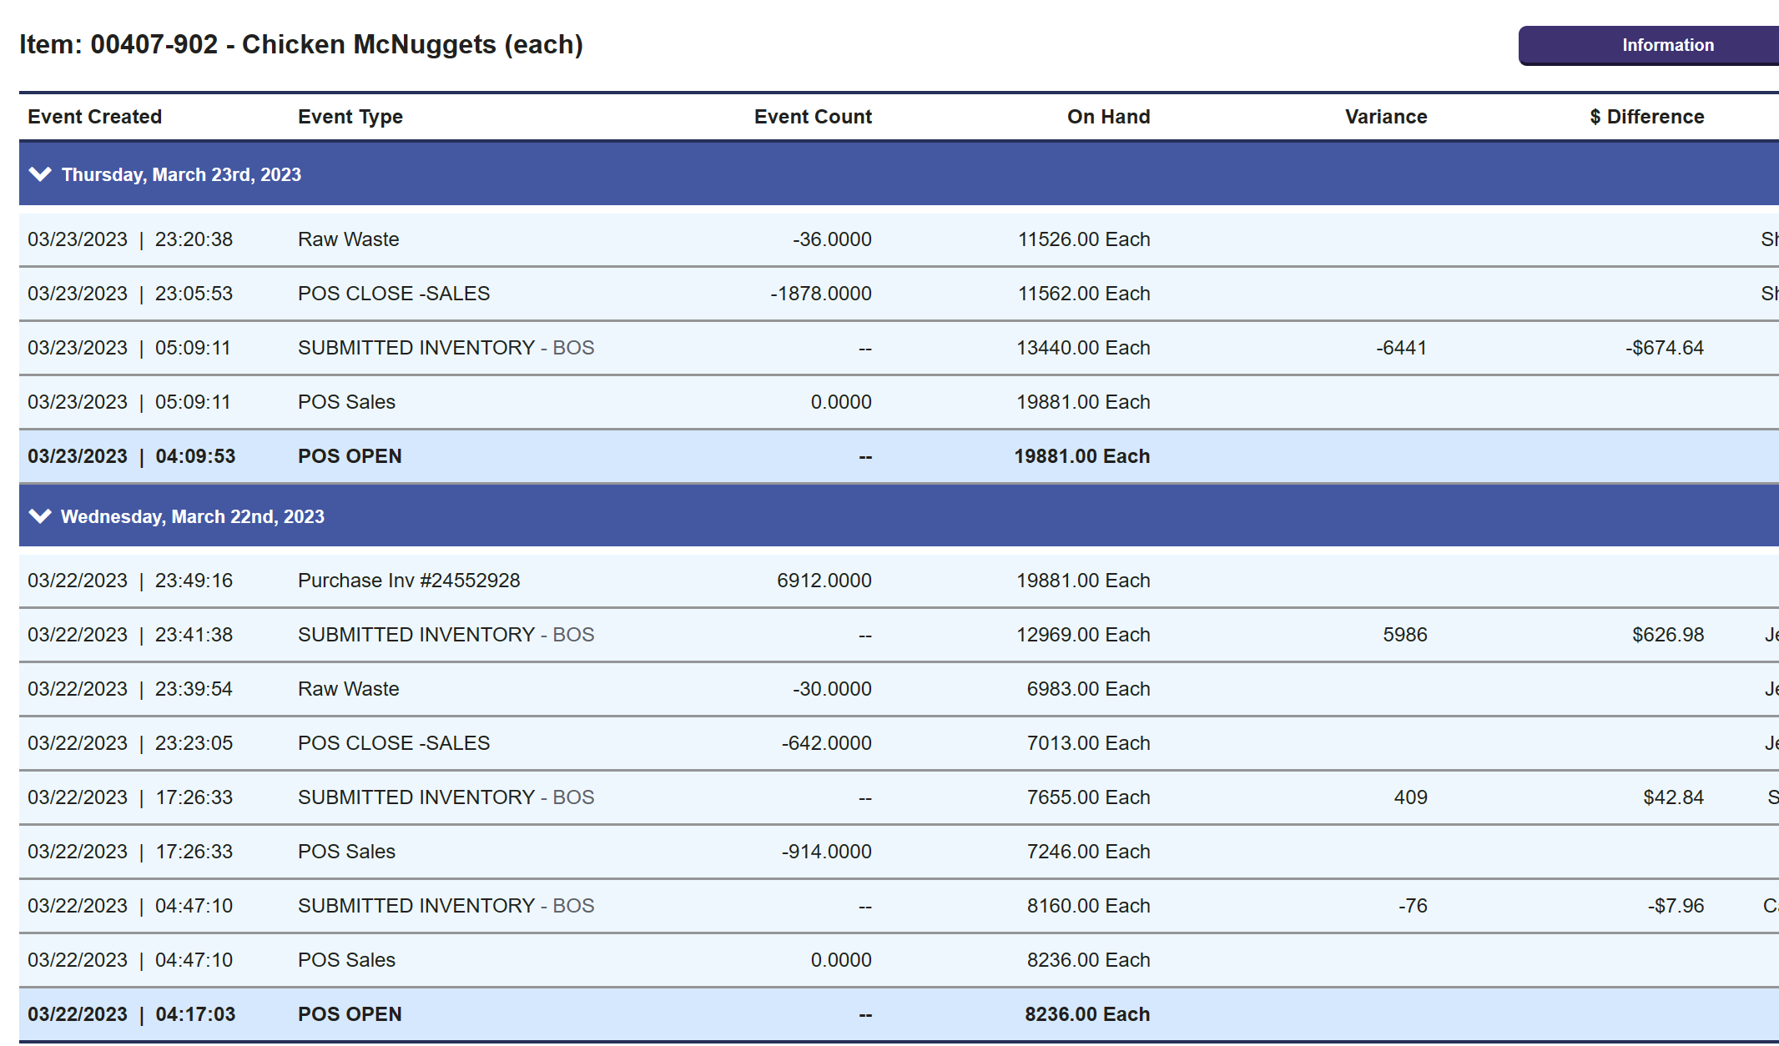
“Food Cost was good Yesterday”
Notes:
Here is an example of perpetual inventory
This restaurant inventories 6 items, 3 times per day
However the closing manager forgot to approve the truck
FOB on Wednesday evening looked great, Thursday morning (after 6am) back to usual

Slide 17
Questions?

Slide 18
Raw & Competed Waste
Communicate Targets
  Managers must have a goal in mind
Observation / Action / Routine
  Optimize Manager’s Floor Control skills
  Enter waste per shift using McD tablet
Notes:
Step 1. “Communicate Guidelines” (Targets). In order to fix a problem the manager must know what the “end” is. How much waste should I have as a shift manager, or at least per day.
I should know what is a “normal” amount. If my raw waste target is 0.5% and I do about 10,000 per day then I should see about $50 or less in waste each day.
Discuss first accuracy step, “Floor Managers skills”. No problem, food cost or otherwise, can be fixed without involvement “on the floor”. Now this is where we get into some of the daily routines that the managers must do every day.
Question: Do you have a tablet that the floor managers use for Food Safety or FRED training?
Discuss: That same tablet can be the tool the floor manager uses to record raw or completed waste. Just like you on your laptop they can access the raw & completed waste screens while they are working on the floor during their shift

Slide 19
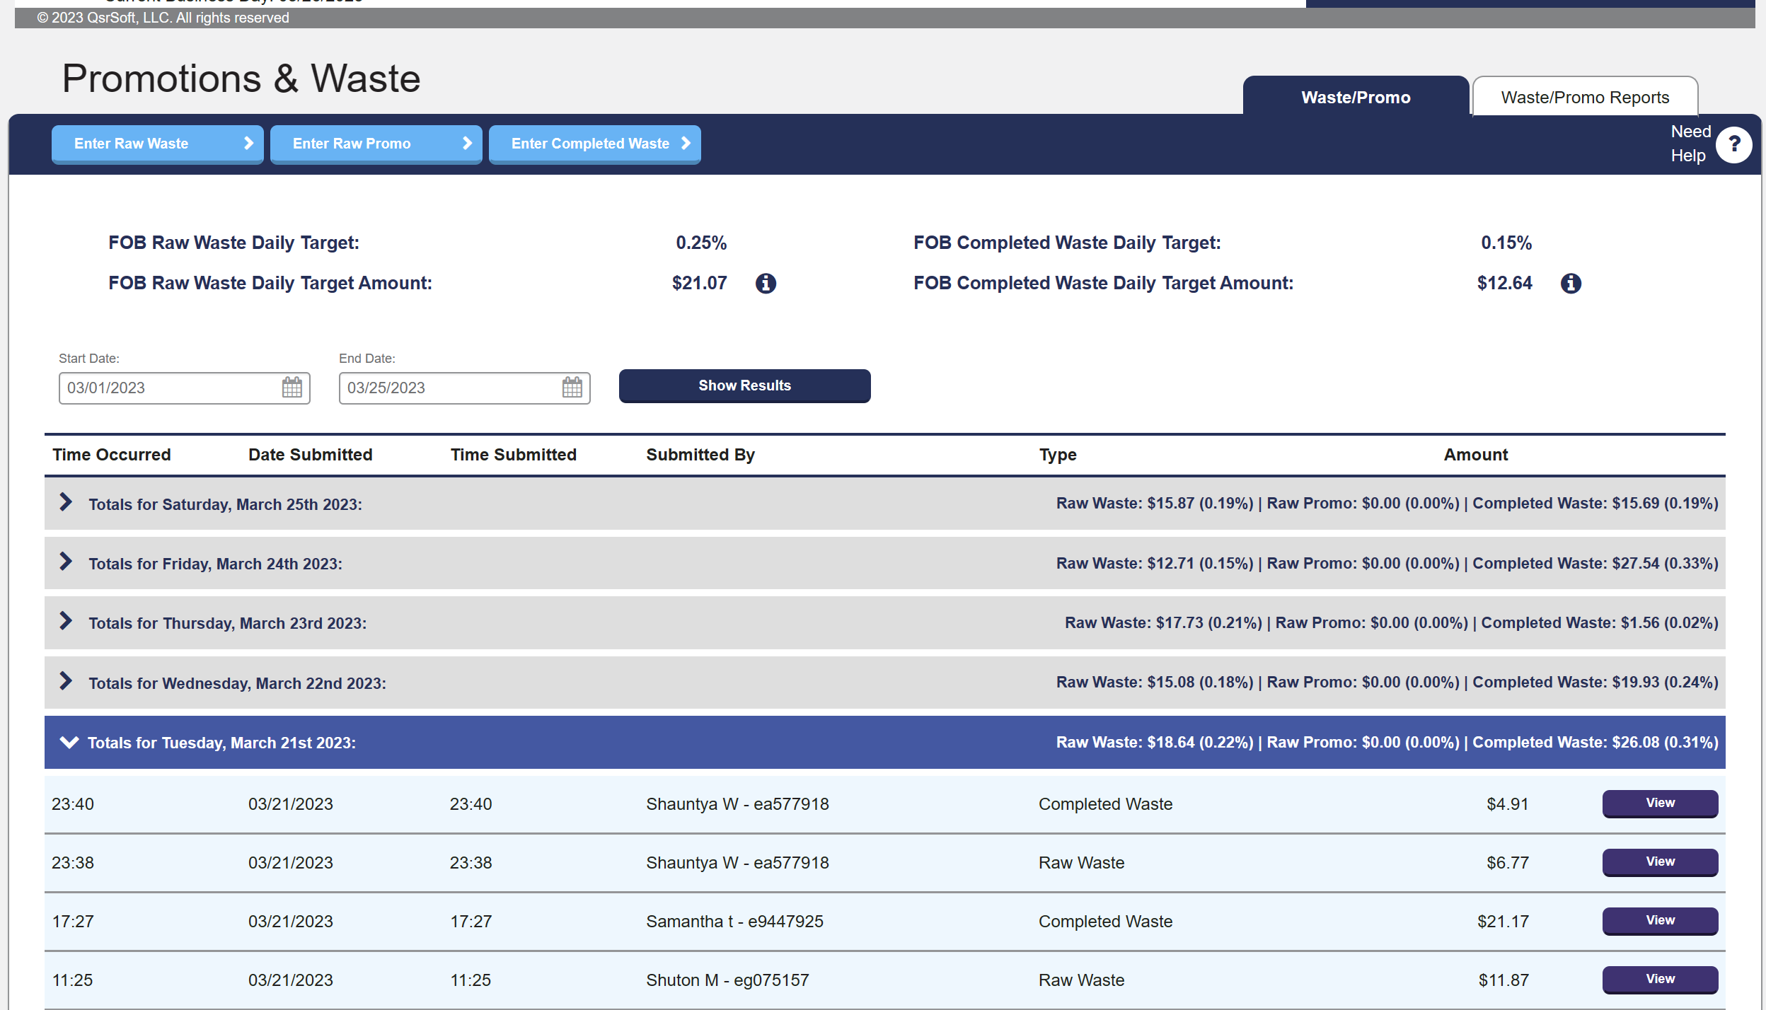
Do daily & shift waste entries exist?
Report
Targets
Raw
Comp
Shift
Notes:
This is an example of the promo and waste screen. I open this and scan down the raw and completed columns looking for zero’s, I expect values here.
Question Is your value close to your daily target dollars?
If waste is missing, you can add to current day and re-inventory those items again.
If I click on one day, I can see the entries and confirm if waste is being tracked by shift.
First let’s talk about how the Inventory system works. For waste the system shows you a blank list of items when you access the screen.
Question: If I need to waste an item that is not on the list what do I do?
Answer: and type in the WRIN number or name to find the item and add to the list.
Question: Can more than one manager enter the raw waste?
Answer: Yes, and this is a big change as the system will automatically accumulate the waste for you.
As a supervisor, I’m reviewing this page for any zero’s or “low numbers” below the daily targets. I’m reviewing some entries to check for shift manager entries.

Slide 20
On-the-Floor
Entered per shift
Waste containers
Equipment problems communicated / solved / sharpened
Secondary shelf-life labeled / UHC level communicated
Squeeze or shrink-wrap
ROP recommendations
Notes:
Where does waste come from on the floor?

Slide 21
Questions?

Slide 22
Transfers
Transfer out / in must be completed at time of receipt
Managers job is not complete until transfer is approved
Notes:
The next function is transfers-in, but we will group both transfers in and out together. The screen works like the the purchase screen. After all, a transfer is the same as a purchase.
Question: Who should be responsible for the entry of the transfer?
Answer: Once again you want to set the stage for a standard. Most of the time it should be the manager who received or gave-up the product.
Question: Do I have to enter a transfer in for any transfer out that I did? What about <Deleting> the transfer? (reject)
Answer: In the ISP world, each time that you delete a transfer you are creating both stat-loss and or unexplained difference. Use “Transfers” screen to validate no missing entries for the month
Create accountability for “Out Restaurant” Shift Manager to create transfer at that time
Create accountability for “In Restaurant” Shift Manager to approve transfer at that time
If transfer is missing, add to current day and coordinate with other restaurant for approval; re-inventory those items again

Slide 23
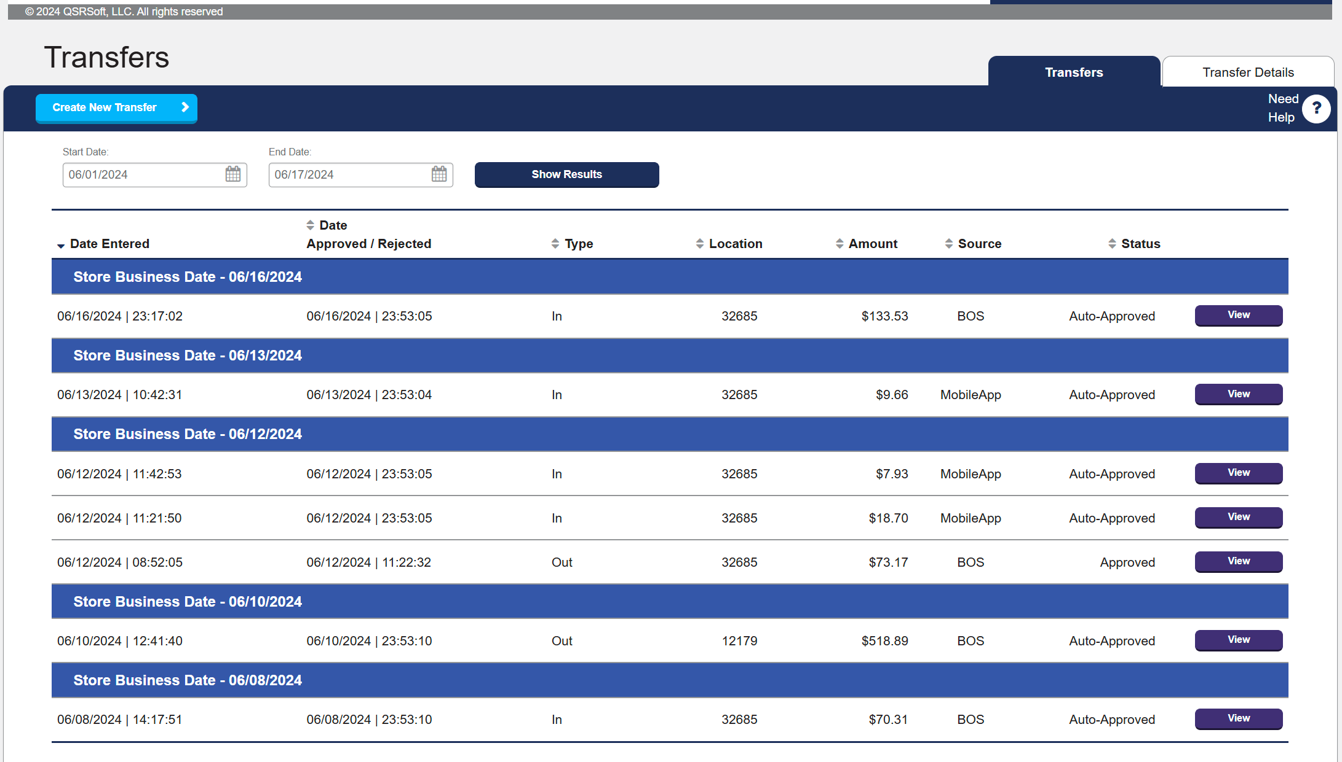
Do transfers match actual?
Date
Status
Notes:
On the transfer page I can see a summary of all of the in / out for the month. First thing I want to know is do these match with what I expect? The second is were these manually approved, or were they auto approved?
It’s important to remember, until the “In” approves the transfer, the inventory isn’t moved from one restaurant to another. So on the “out” I’m looking at at if the other restaurant approved manually or automatically. For transfers we auto-approve at either 11:45 pm, or at store opening if the transfer was done overnight.
While you could say the goal is to have zero transfers, typically a few are acceptable. As a supervisor, what to look for on this screen is if you have to scroll down to see the full transfer list.

Slide 24
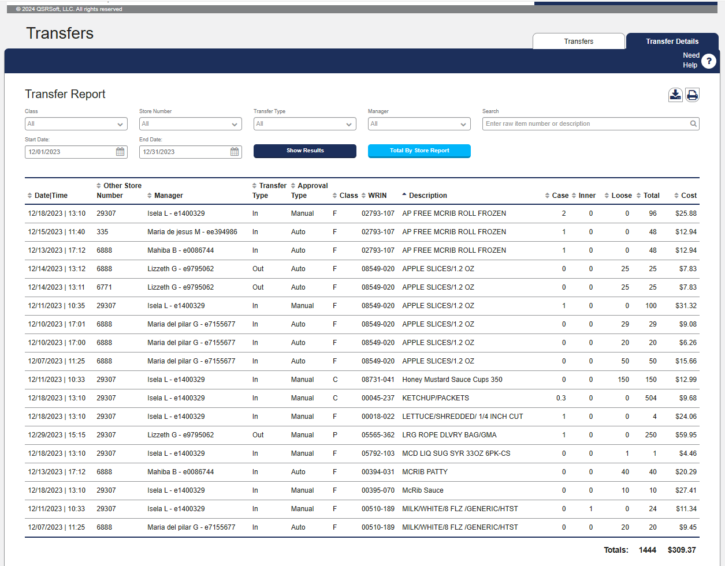
Is there a common item / pattern?
Sort
Notes:
On the transfer details page I can see the same information as the summary page with all of the raw items visible?
I sorted by WRIN, ask the questions about McRib buns, and Apple Slices, was this us running out, is it an ordering issue? What can we do to prepare?

Slide 25
On-the-Floor
Both transfer out and transfer in managers approve at the time the transfer is completed
Review ROP proposals
Targets
Notes:
Did both shift managers complete the transfer
Review ROP , what items got over-ridden, what items got transferred
Targets, no more than 1 per week

Slide 26
Questions?

Slide 27
Purchases
Purchases must be completed at time of receipt
Managers job is not complete until purchase is approved
Manager must report missing or damaged
  Follow-up on Adjustment / Credit
Notes:
Question: Who should be responsible for the entry of the purchase?
Answer: Once again you want to set the stage for a standard. Most of the time it should be the manager who received the product.
Question: What is you process for when a product is missing or damaged during delivery? Do all managers know this process? (Note it can vary by DC)
Discuss: For returns or missing, the system has two parts, the Adjustment to inventory, and the Credit to the ledger for unexplained
Question: What happens if I do an inventory on the same day as I receive a truck delivery?
Discuss: Remember the nugget example in the beginning? It is all about timing,
Answer: I can do inventory before or after the truck. The key is did I (or not) approve the truck and is the truck inventory part of what I counted.

Slide 28
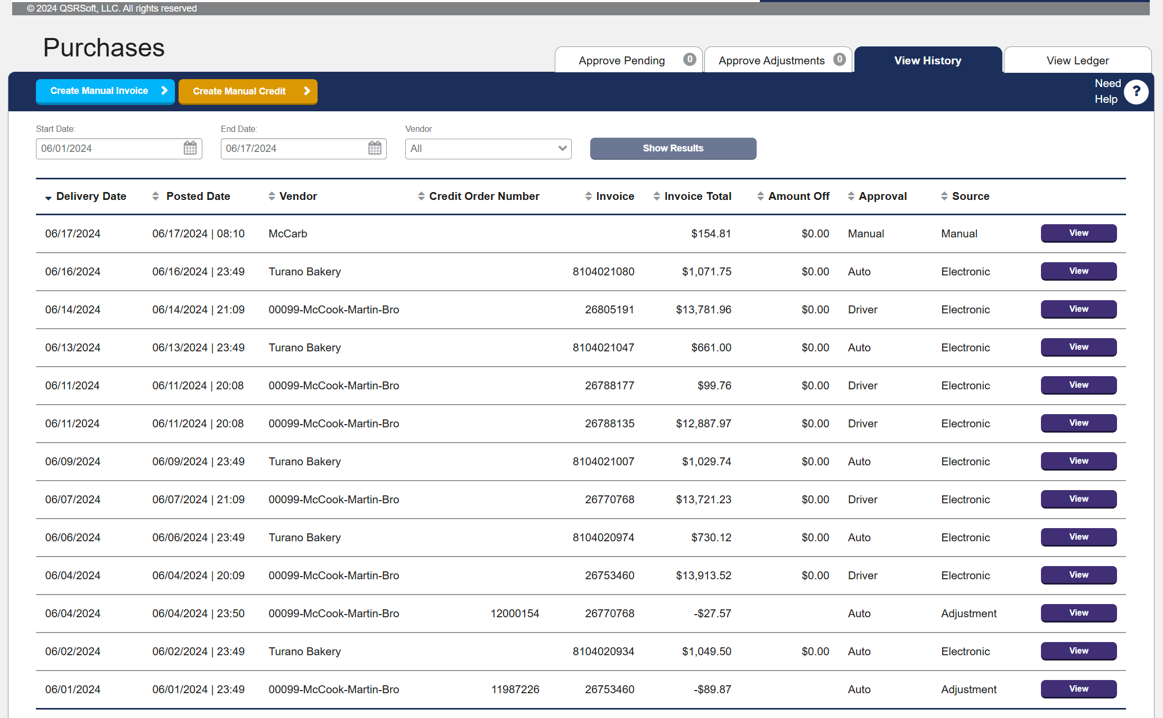
Do purchases match actual?
Date
Approval
Notes:
Receiving manager job is not done until truck is put away and “Approved” in purchases
Use “View History Tab” inside of “Purchases” screen to validate timely posting. Check for the same in the Adjustment tab.
As a supervisor I’m looking to see if the purchases or adjustment is being approved in a timely manner or did the system auto-post.
Managers can also get alerts via the “Home Screen” notifications to approve any “Purchases” or “Adjustments”

Slide 29
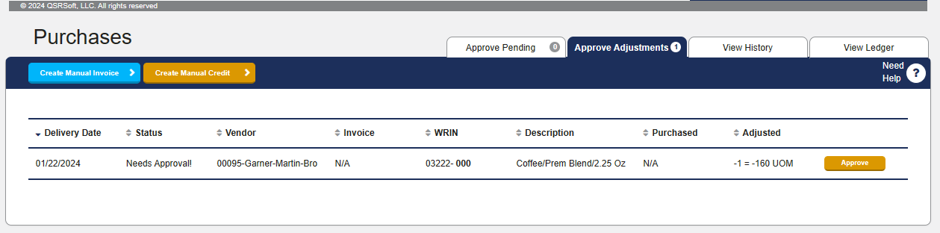
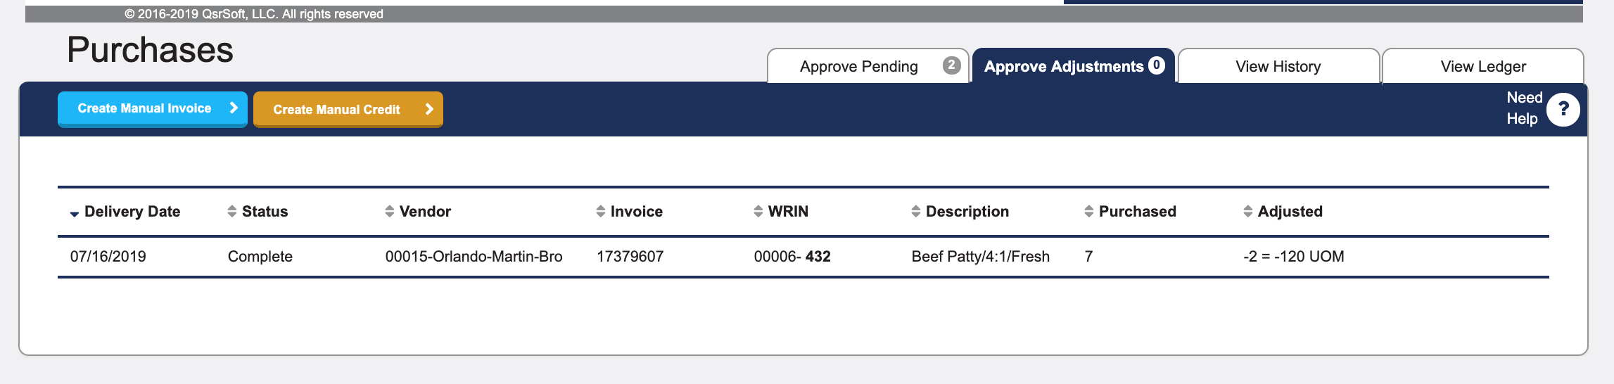
Adjustment waiting for credit?
Case
Adjustment
Notes:
Approved adjustment waiting for matching credit
With the approved adjustment, my stat report is now cleaned up.
When credit comes, screen is cleared
As a GM this is significant. If the adjustment is still appearing here, then the matching credit is not received. This will lead to a higher unexplained difference until the credit arrives.

Slide 30
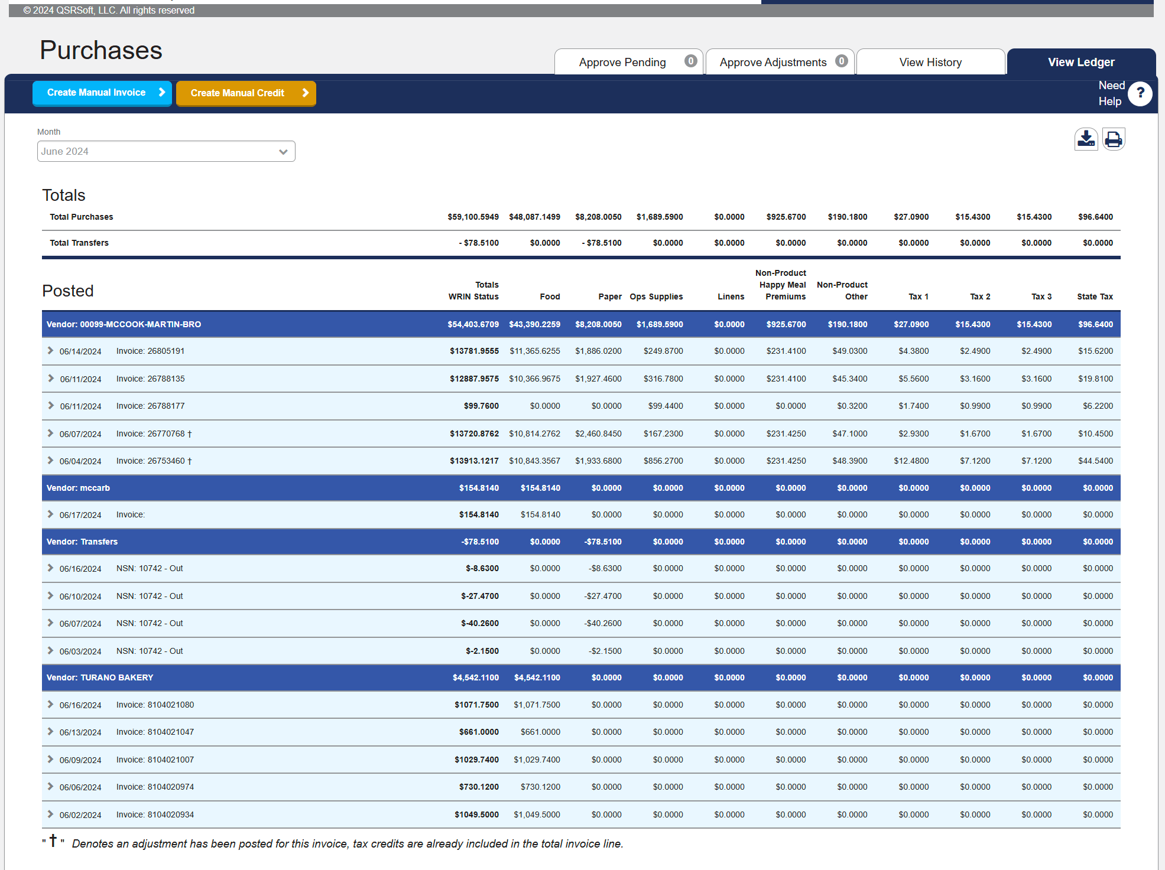
Does ledger show credits?
Adjustment & Credit
Notes:
The last tab in purchases is the ”View Ledger”, for any missing or damage, the “Adjustment” to the inventory shows up under adjustments first.
Then when the credit is applied the ledger shows a “dagger” or cross symbol. At that point the adjustment screen is cleared.
The adjustment fixes the stat report and the credit fixes the unexplained difference.
As a supervisor I want to know any Approved Adjustment who’s credit has not posted. Click on the approved adjustment tab to see if any exist.

Slide 31
On-the-Floor
Rotate and put away
Assisted & unassisted delivery roles
Labels , locations, stacking
Equipment temperatures & gaskets

Slide 32
Questions?

Slide 33
Maintenance
(Part 1)
On Hand Inventory
  Duplicates
  Last Submitted
Notes:
Complete maintenance weekly (before any inventory)
Click on “Last Submitted” to sort and find items without an inventory (or over 30 days); record those items to either deactivate or to complete an inventory
Un-check “non-zero” and check “duplicate” to “Show Results” for items switching WRIN numbers, assure inventory is under correct WRIN
Complete this process for WRIN classes or Food, Condiments, Paper and Non-Product

Slide 34
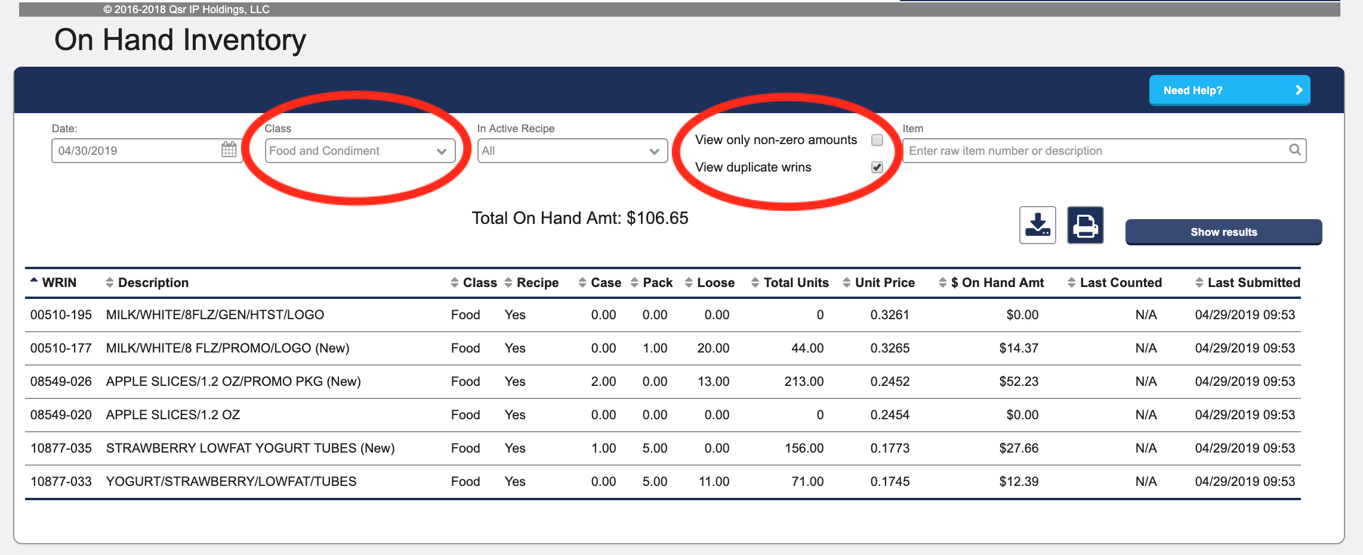
How do I check for the “right” inventory?
Use “On Hand Inventory” with “View Duplicate” to find excess inventory
Notes:
One common question we get is, the system says I have more inventory than I believe is on hand. I refer to that as “runaway inventory”.
Many times that has to due with the WRIN numbers as we switch, managers accidentally put the whole inventory under BOTH WRIN numbers by mistake.
An easy way to find this issue is to use the On Hand Inventory screen. With the new web-based tools you can manipulate the list to help you find what you are looking for.
In my example I am focused on my food and condiments, I have also focused on those items that have duplicate WRIN numbers and I am including items with or without a count.
You can see here that Milk is in the process of changing. The manager has recorded more inventory under the new number than the old number which seems appropriate as a product is getting migrated away from. It is when you see high numbers on both you will want to follow-up.
If you change the category to non-product the list gets longer due to happy meals. Be sure to search on last submitted for happy meals and put in a zero inventory for ones you no longer have in the restaurant. Then use WRIN management to deactivate any of these WRIN’s.

Slide 35
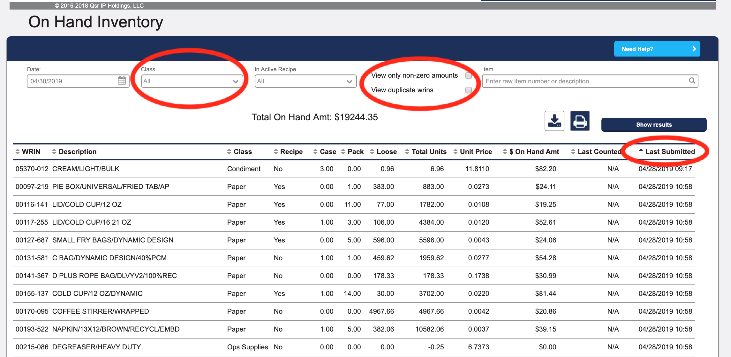
How do I check for “missed” inventory?
Use “On Hand Inventory” sorted by “Last Submitted” to find missing inventory
Notes:
The other common question we get is, how do I know if I am “missing inventory”.
The answer is also on the “On Hand Inventory” page.
Now uncheck both non-zero and duplicate, you can change the class to all (or any subset if it isn’t EOM) and click on show results and sort by Lat Submitted.
If an item has never been inventoried it will show an NA, if it hasn’t been inventoried in many days those will be at the top of the list.
Sometimes those will be the same as the duplicates for items that we have transitioned away from.
Supervisors need to follow-up on items with very old inventory dates or NA.

Slide 36
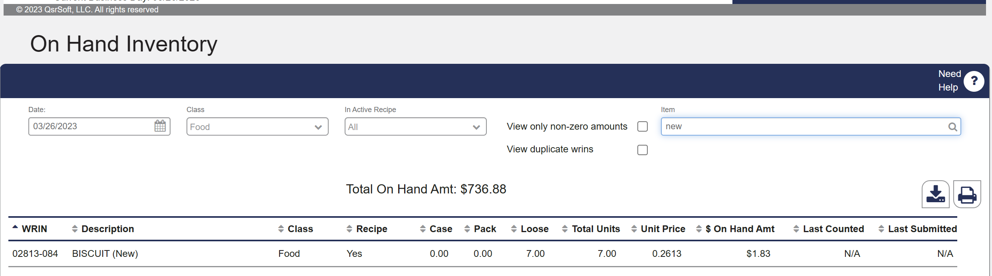
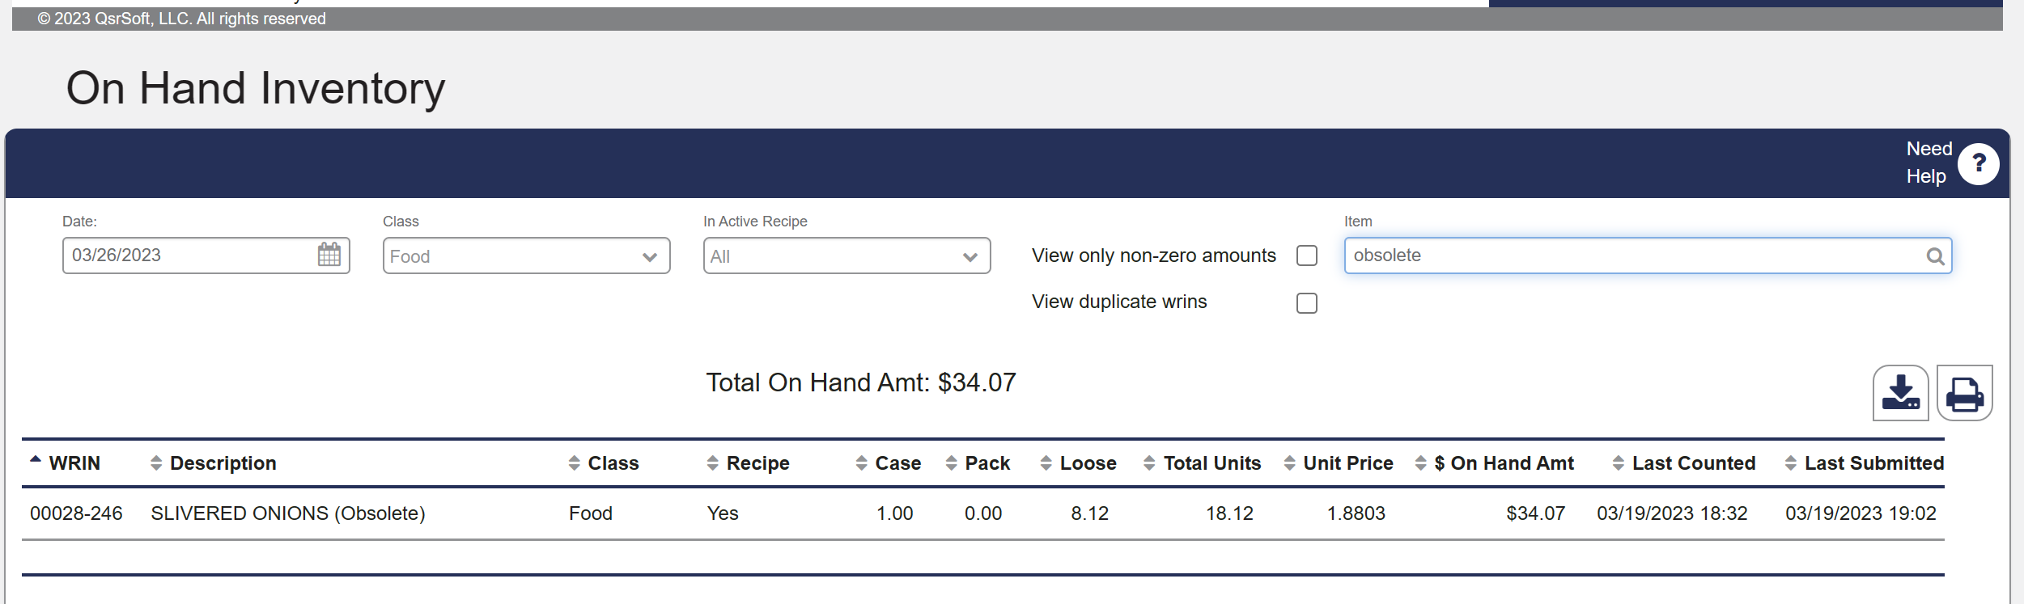
New and Obsolete
Notes:
It is important to take action on items tagged as new or obsolete
For new items, make sure they are setup correctly
For obsolete , waste and zero inventory as needed.

Slide 37
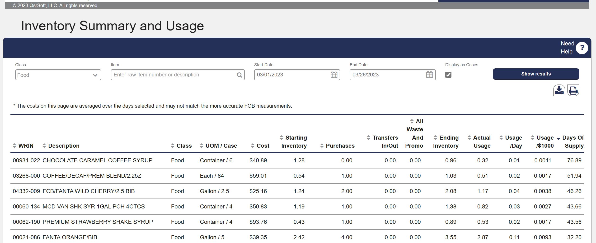
Inventory Summary
Days of Supply
Notes:
Another inventory follow-up tool is Inventory Summary
Groups waste / transfers / purchases, plus starting inventory minus ending inventory
Provides a usage per thousand and a days of supply
View as cases or units

Slide 38
Maintenance
(Part 2)
WRIN Maintenance tab
Notes:
Maintenance via “WRIN Management Tab” located in “Physical Inventory”
In "Physical Inventory” switch to “WRIN Management” and allow list to load; select “Deactivate box” and click “Deactivate button” to remove legacy WRINs
Use “Items to Inventory Tab” and “Submit” a zero count if needed to allow for deactivation

Slide 39
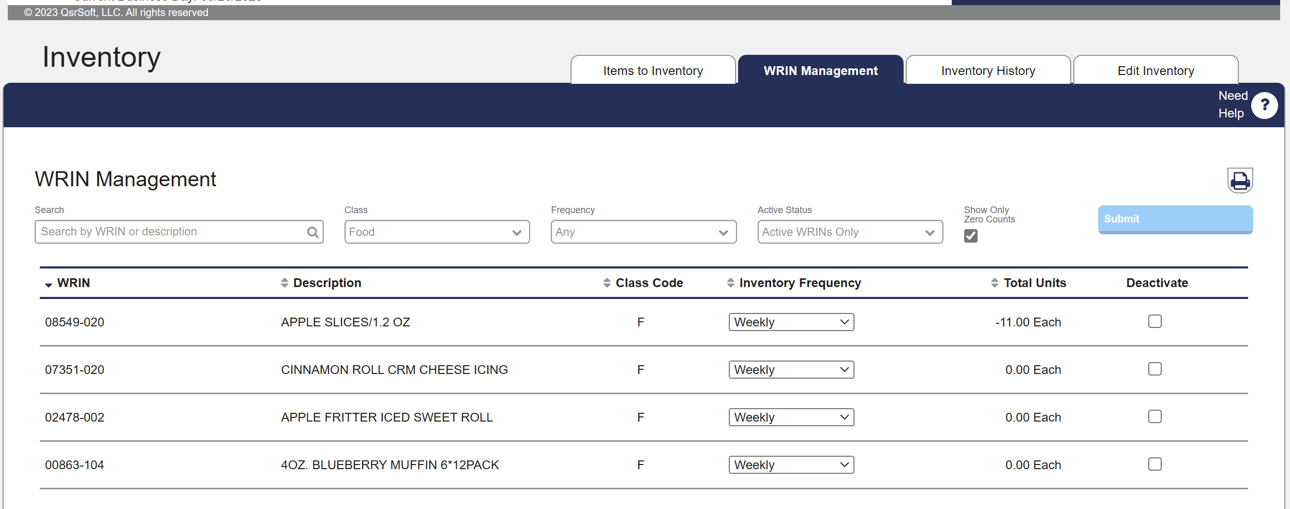
How do I remove items from my lists?
Use “Physical Inventory – WRIN Management” to Deactivate
Notes:
If you do nothing, the system will automatically deactivate anything with zero inventory after 25 days. For accuracy during waste and inventory it’s important to maintain this information regularly.
If something needs to be deactivated right away, just switch over to the “Items to Inventory” and submit a zero inventory. Then switch back to deactivate.
This is also where you can easily change the daily / weekly / monthly lists

Slide 40
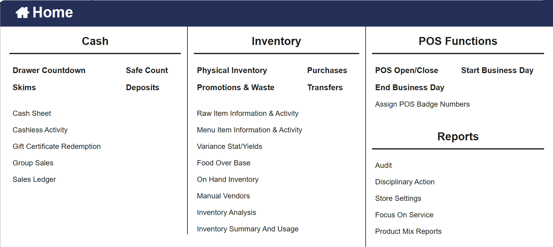
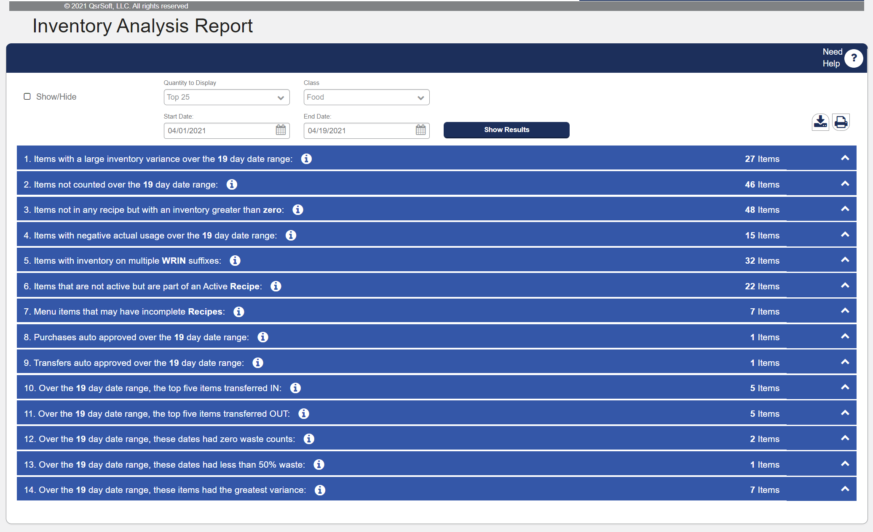
Inventory Analysis Report
Notes:
To help you with all of the topics we have covered a report exists to help troubleshoot food cost. The Inventory Analysis report is available from the menu and provides multiple topics to evaluate and look for opportunities in improve food cost.
Click on the topic to see the items in each area. Use your mouse and hover over the “I” to view a suggested action item for each area.
Some key items that match with our “maintenance tasks” are 3 & 5

Slide 41
Questions?

Slide 42
Physical Inventory
After close, all 500+ WRINs all at the same time, all submitted together
Now, small batches, submitted right away, repeat
Complete after:
  Waste / Transfer / Purchase / Maintenance
Notes:
If you have not changed the way you are completing your Physical Inventory since the transition, then you are not truly taking advantage of the new capabilities in accuracy and efficiency
In the past, you kept counting and counting and counting, until you were done counting. Then you submitted it all. In this more modern system with it continually recording, it makes more sense to count in small batches or groups of items.
First, always update Info Recorder before taking inventory, also as we discussed earlier, make sure waste, transfers and purchases are all entered and approved. If you are using the QsrSoft Mobile Inventory App this is done automatically.
When possible, scan every case with the Info Recorder or the Mobile App so that changes to WRIN numbers are automatically recorded under correct WRIN
Complete inventory in batches of 20 items and “Submit” each time; don’t wait until the end to “Submit”; count breakfast items during slower lunch times; count lunch items during slower breakfast times
“Submit” {green} items right away; review and troubleshoot {yellow-red} if necessary; remember to "Check Box” for {yellow-red} and “Submit”

Slide 43
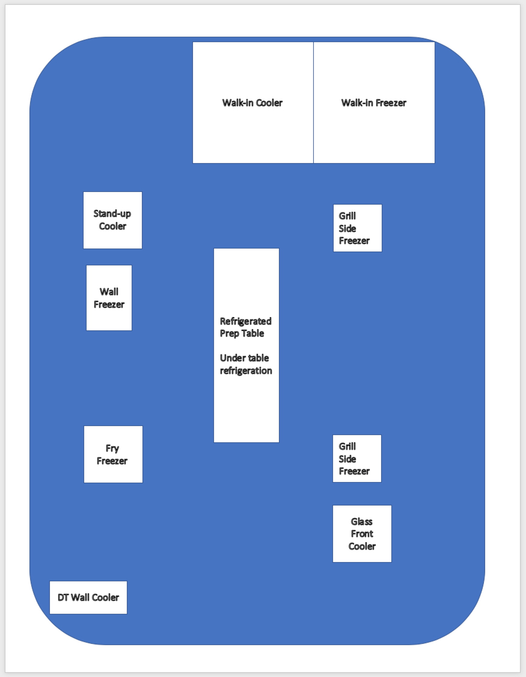
How do I count in “small batches”?
Inventory
Locations
Notes:
Let’s talk about what a small batch is. In the ISP days it didn’t matter how long you took to complete the inventory. You would wait until close (or close to it) and count-and-count-and-count until everything was counted because you needed the ISP to also finish the business day.
Because C&I is constantly calculating the perpetual inventory, the longer you take to count, the more inaccurate you will become. What’s worse is if you become interrupted for a long period of time (an hour or so) during a count it really means you should start over again
Counting in small groups keeps the inventory from going “stale” while you are counting.
Question: Image in your mind, you just opened the door to your walk-in freezer in the back. What items do you see on the left side of the freezer (allow someone to name off 8 or so).
Question: Do those items also exist in the grill side freezer, or a wall freezer?
That is a batch. Inventory those 8 items, making sure to inventory all area’s where they are stored, then upload the inventory, review and submit.
Now you are ready for your next batch, maybe the right side of the freezer and it’s additional locations.
Each batch is uploaded, reviewed and submitted. No need to wait until we are all done, don’t let those counts get stale.

Slide 44
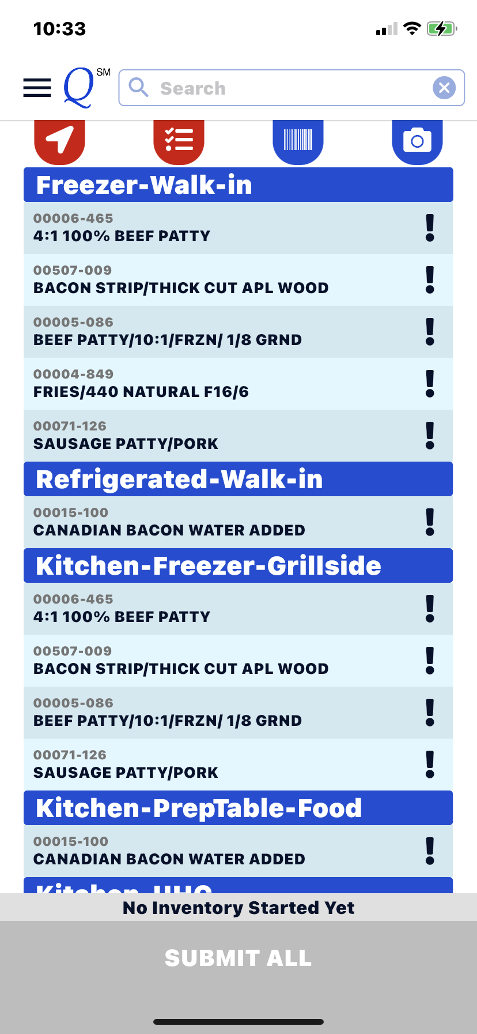


QsrSoft Mobile Inventory App
Missing Locations ?
Menu > Settings >
Use Default Locations
Enable
D / W / M
Enable
Locations
Inventory
Locations

Slide 45
Small batch inventory
Walk-in
Freezer
Left
Side
Fries
This could be part of a weekly inventory
Take inventory in a location and click “Save”
Must inventory all locations for each product before “Submit”
Divide up your inventory across the shift and across the dayparts
Hashbrown
Crispy
McChicken
Nuggets
Qtr Buns
Mac Buns
Reg Buns
Notes:
Let’s talk about what a small batch is. In the ISP days it didn’t matter how long you took to complete the inventory. You would wait until close (or close to it) and count-and-count-and-count until everything was counted because you needed the ISP to also finish the business day.
Because C&I is constantly calculating the perpetual inventory, the longer you take to count, the more inaccurate you will become. What’s worse is if you become interrupted for a long period of time (an hour or so) during a count it really means you should start over again
Counting in small groups keeps the inventory from going “stale” while you are counting.
Question: Image in your mind, you just opened the door to your walk-in freezer in the back. What items do you see on the left side of the freezer (allow someone to name off 8 or so).
Question: Do those items also exist in the grill side freezer, or a wall freezer?
That is a batch. Inventory those 8 items, making sure to inventory all area’s where they are stored, then upload the inventory, review and submit.
Now you are ready for your next batch, maybe the right side of the freezer and it’s additional locations.
Each batch is uploaded, reviewed and submitted. No need to wait until we are all done, don’t let those counts get stale.

Slide 46
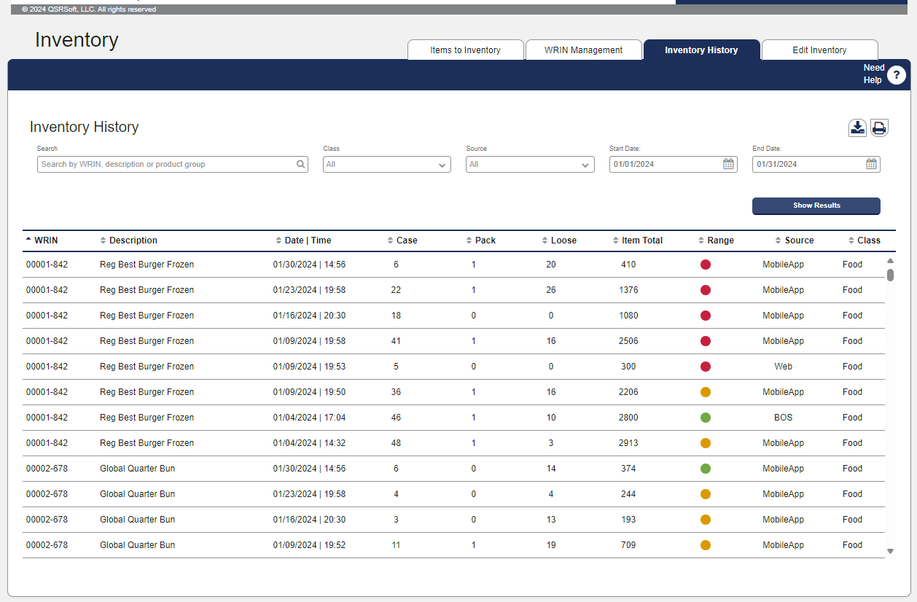
Inventory History – Process & Accuracy
Used to evaluate process & accuracy, part of action plans.
Use Search or Dates to limit
Ask the question, what days should I expect inventory?
Ask the question, how did they count inventory?
Ask the question, did they have to re-count?
Ask the question, what was the pattern of Range accuracy?
Batch
Notes:
In the physical inventory is a function that will allow you to monitor the efficiency and accuracy of the managers
Supervisors; use “Inventory History tab” from the Physical inventory screen to evaluate accuracy of inventory with {green-yellow-red} and quantity of re-counts
Set the date range to your last inventory date. Sort on the Date / Time to see the batch work. Sort on the range indicator to see accuracy reflected in each count.
Sort on the WRIN to see if multiple recounts were needed for items.
Discuss: The wasted time in extra troubleshooting that might be occurring.

Slide 47
Questions?

Slide 48
Variance
Stat
Summarize food cost opportunities
Comparison of calculated usage via recipe to actual inventory usage
Floor managers must act
Notes:
Now we come to the Variance Stat, all of our work so far is key to building a report we can leverage to review our opportunities.
The default sort for the stat is to evaluate highest loss / gain items
Discuss: Most important, what are my top 3 items? Do all managers know those items? Do the crew know those items? Just printing these lists over and over without any on-the-floor follow-up will not provide any results.

Slide 49
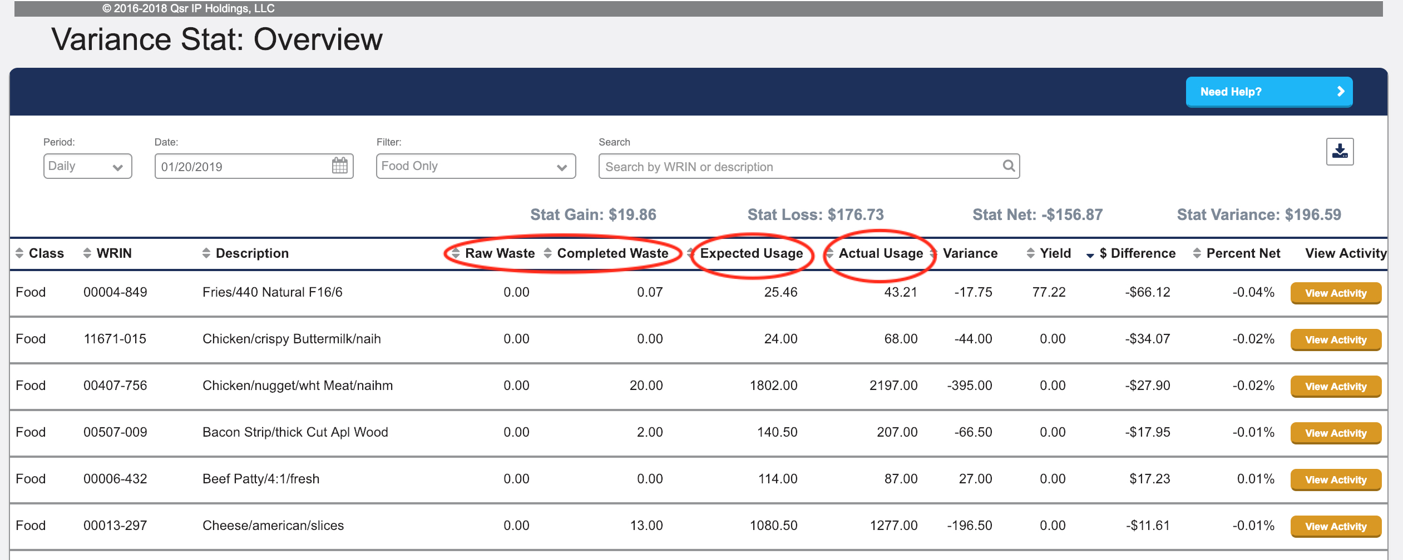
Do I have accurate reporting?
Zero?
Negative?
Notes:
In the waste screen we validated raw & completed waste present at the daily level; (see waste notes above)
If we click on the raw or completed waste headers we can sort and find individual items without waste. In our example here Fries has no raw waste and only minimal completed waste
Next, if we Sort by “Expected Usage”; if something has a zero expected usage check for duplicate WRIN; (see maintenance notes above); this item isn’t generating usage from a recipe
And now, Sort by “Actual Usage”; if negative check for missing transfer or inventory accuracy, a negative actual usage is usually impacting the unexplained difference since a “normal” loss can’t be calculated.
Use the “View Activity”; if variance bounces from negative to positive during the month; (see inventory accuracy notes above), are the managers counting the same way
Discuss: Do you trust the information shown here?

Slide 50
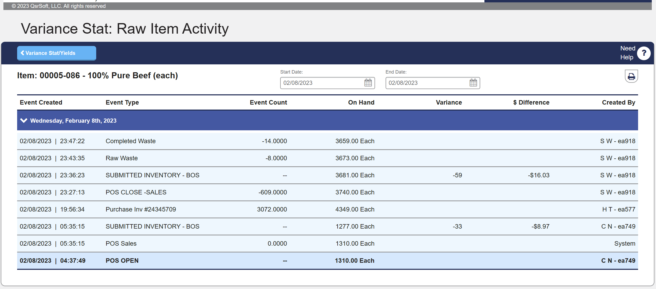
Detailed day-by-day item follow-up
Fix the problem and take another inventory to reset
Notes:
This is the Raw Item Information & Activity screen. This is available via the stat report or as a separate menu option.
The screen shows us the formula for actual usage. Which is beginning inventory, plus purchases plus transfers in, minus transfers out, minus raw waste, minus raw promo, minus ending inventory.
Question: What can we use this screen for?
Answer: Follow-up and accountability. Look for missing information for waste, transfers, or purchases on common items (like fries, nuggets). Look for variance numbers switching between positive and negative that might indicate someone not counting or incorrect counts.

Slide 51
On-the-Floor
Record waste after each shift and by manager
A manager checks in the truck and approves the invoice or transfer, follow-up on adjustment / credit
Equipment Maintenance
Complete Inventory / Review On Hand Inventory
Complete regular maintenance
Stockroom Organization
Update the Info Recorder; scan as much as possible; use QsrSoft Mobile Inv App
Ring up employee meals at the time of the meal, control manager POS passwords
Monitor T-Red, B-Red POS actions
Notes:
These are actions that the floor managers will complete, with some exceptions. I’m hopeful some of you took one or more of these actions as part of your action plans.
We have discussed the important of each with it’s relationship to food cost. However, there are two more that are also key to accuracy.
{Instructor CLICK for transition}
The first one can surprise some managers. Remember that the food cost numbers are all generated by ringing in orders to the POS. If security is lax, then promo’s or T-Red / B-Red can be caused by theft and will also create food cost inaccuracy
Organization of the restaurant is also key to accuracy. If the managers find it hard to complete inventory because the product is scattered in the restaurant, or is never in the same place twice.
Discuss: Do you have security or organization action items you need to complete in your restaurant.

Slide 52
Questions?

Slide 53
EOM
3 days Dry Stock
2 days Frozen
1 day Refrigerated
Last – follow-up / re-inventory
Last – Happy meal
29th | 30th | 31st
Day -3 | Day -2 | Day -1
Dry Stock | Frozen | Refrigerated Follow-up Happy Meal
Notes:
The EOM process is a big change. Both the McDonald’s TKIT and the QsrSoft Academy have a lot of information and checklists to assist.
One recommendation is to do this; 3 days before EOM count dry-stock; 2 days before EOM count frozen-stock; 1 day before EOM count refrigerated-stock
This is working on the items in your restaurant in order of code date.
Make sure to Complete the Maintenance sections from above for ALL WRIN classes
Last day of month; evaluate Variance Stat for “Food” and re-inventory any item with errors
Last day of month; sort Variance Stat for “Condiments” by “Actual Usage” and re-inventory any item with exceptionally high usage or negative usage
Question: What is the most common highest used condiment in the restaurant?
Answer: It’s Catsup packets. If you open the condiment stat report and sort on actual usage anything with a higher usage is usually in error. Oil is the most expensive condiment and can always use a second look.
Last day of month; evaluate Variance Stat for “Paper” and re-inventory any item with errors; Sort by “Actual Usage” and re-inventory any item with exceptionally high usage or negative usage
Last day of month; inventory non-product toys; use “On Hand Inventory”; Select class of “non-product”; Un-check “non-zero” and check “duplicate” to “Show Results” for items; Print list and complete inventory; assure “zero” is submitted for items not present

Slide 54
Questions?

Slide 55
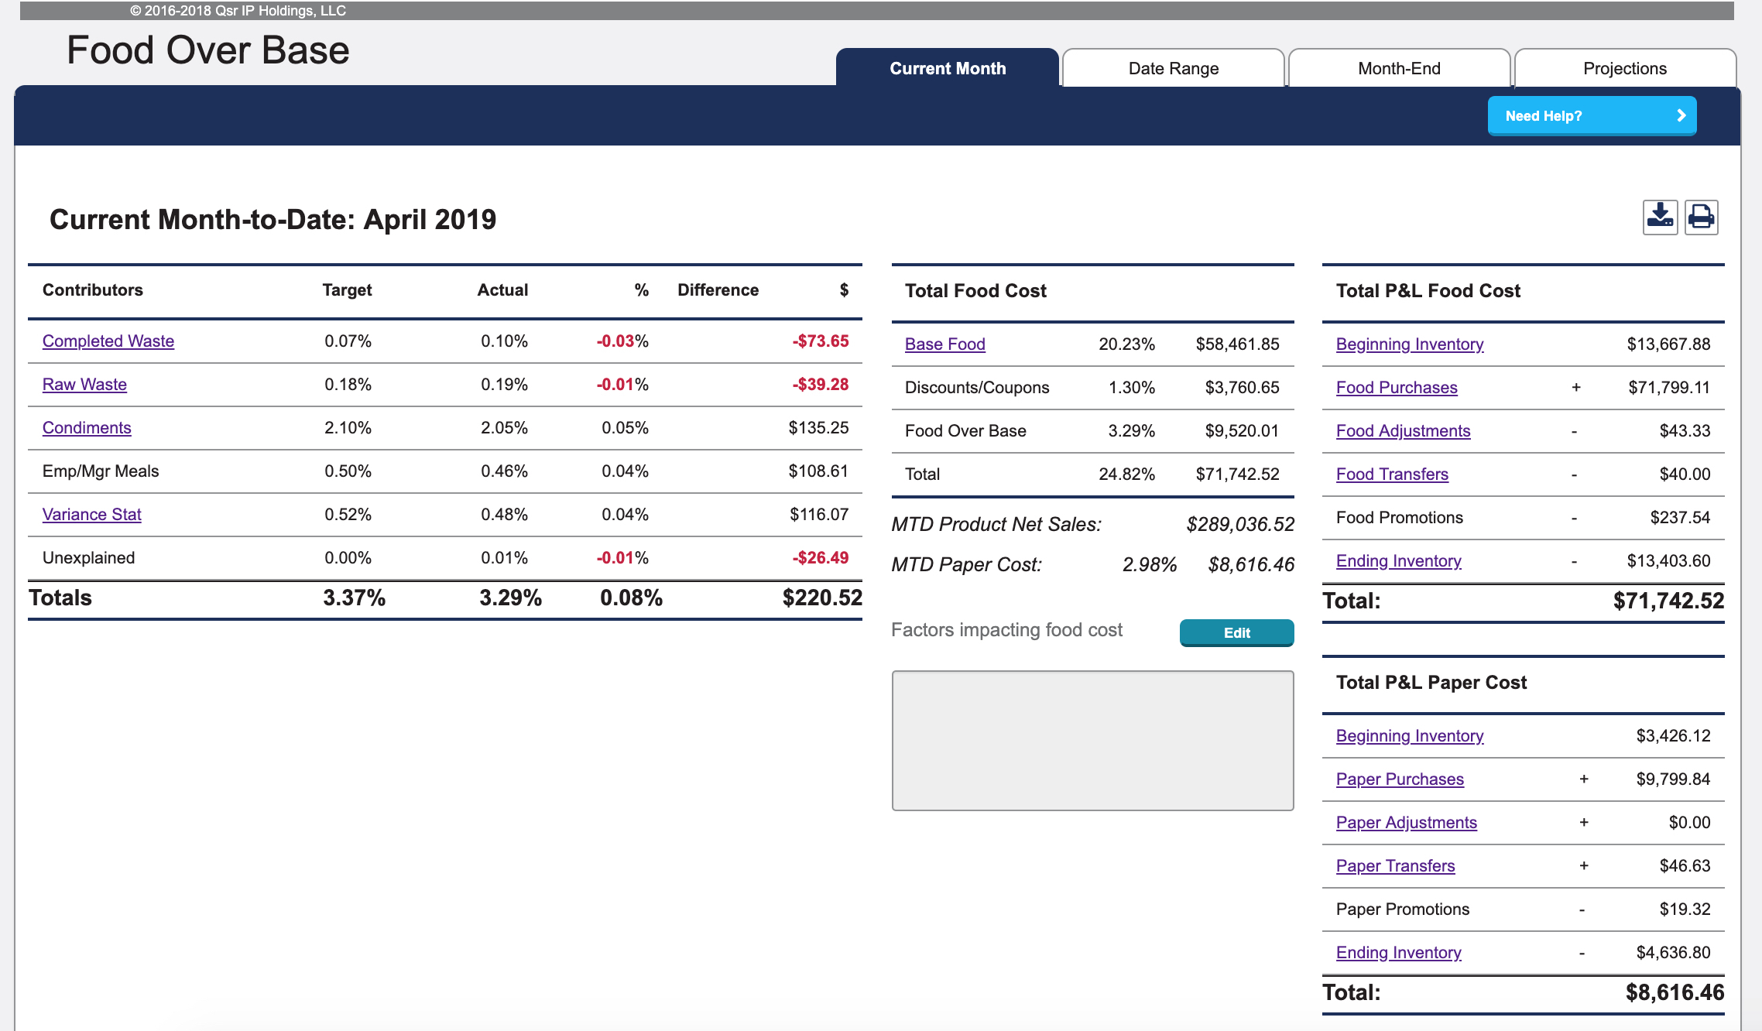
Food Over Base
Notes:
We’ve been looking at food cost from the bottom up, but the true measure is from the top down, the Food Over Base and the P&L Food cost
Looks at the FOB page, the contributors on the left, when they don’t match the targets, could equal dollars lost that he has the opportunity to find and reduce!
Each of these underlined links leads to one of the pages we have already reviewed today.
You will complete a lot of analysis from this page and the tabs at the top will help you analyze different timeframes or to complete your projections.
Let’s break down the FOB page.

Slide 56
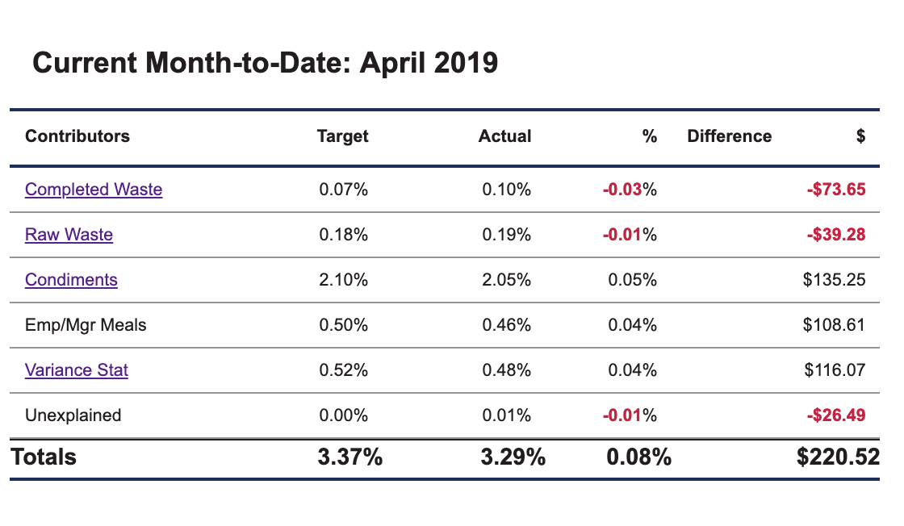
FOB Contributors
Notes:
When it comes to completed and raw waste, we know there will always be some. In fact, he expects to see menu items on this list daily. To see more details about completed or raw waste follows the links on the page.
These columns show your target and our main focus, the actual costs shown as a percentage of sales. The last two are the difference from the target to the actual such that you can focus.
The links to raw & completed will show those daily entries that we started with today.
I’m going to skip condiments for now as I have an example to cover.
Set up and posts employee and manager meal guidelines to minimize dollars lost.
The Variance Stat is very often the area with the greatest opportunity to recoup lost dollars. Work and train his crew to follow product build, also known as the recipe, as closely as possible. Make the crew aware that food loss opportunities are always being monitored and involves them in solutions.
The last item is the Unexplained Difference amount. In an ideal world, mathematically the other components dollars should match the P&L dollar amount. Very often, there are still dollars spent that can’t be accounted for. These dollars are considered unexplained. Things like inventory errors, inaccurate food transfers or purchases, recipe errors or even changes in raw item costs show up in this category.

Slide 57
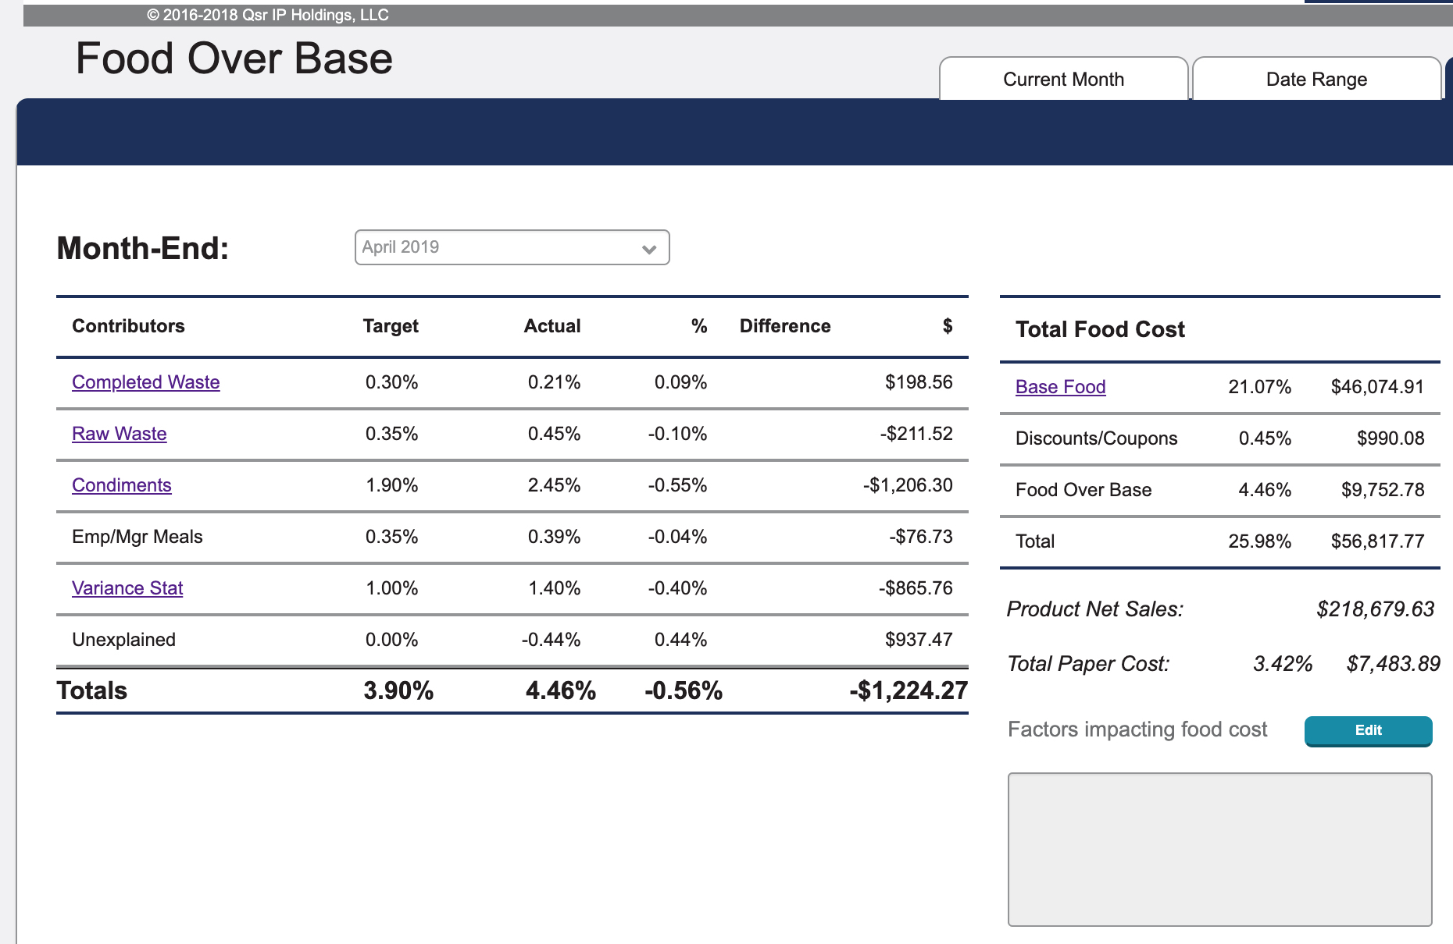
Condiments
Notes:
Let’s give just a minute to discuss condiments.
Condiments, which include salt and pepper packets, ketchup, salad dressings, etc. are another opportunity to keep dollars from flying out the window. With these a posted condiment policies and advises the crew about handing them out.
Fryer oil is also considered a condiment and is something he can manage. Keeps a watchful eye on oil usage and quality. Checks the oil filtering and oil changing procedures. Use additional tools like the supplier oil report to check the food/oil ratio.
In our example here my condiment costs is $1,200 above my target. To investigate any condiment, follow the link.

Slide 58
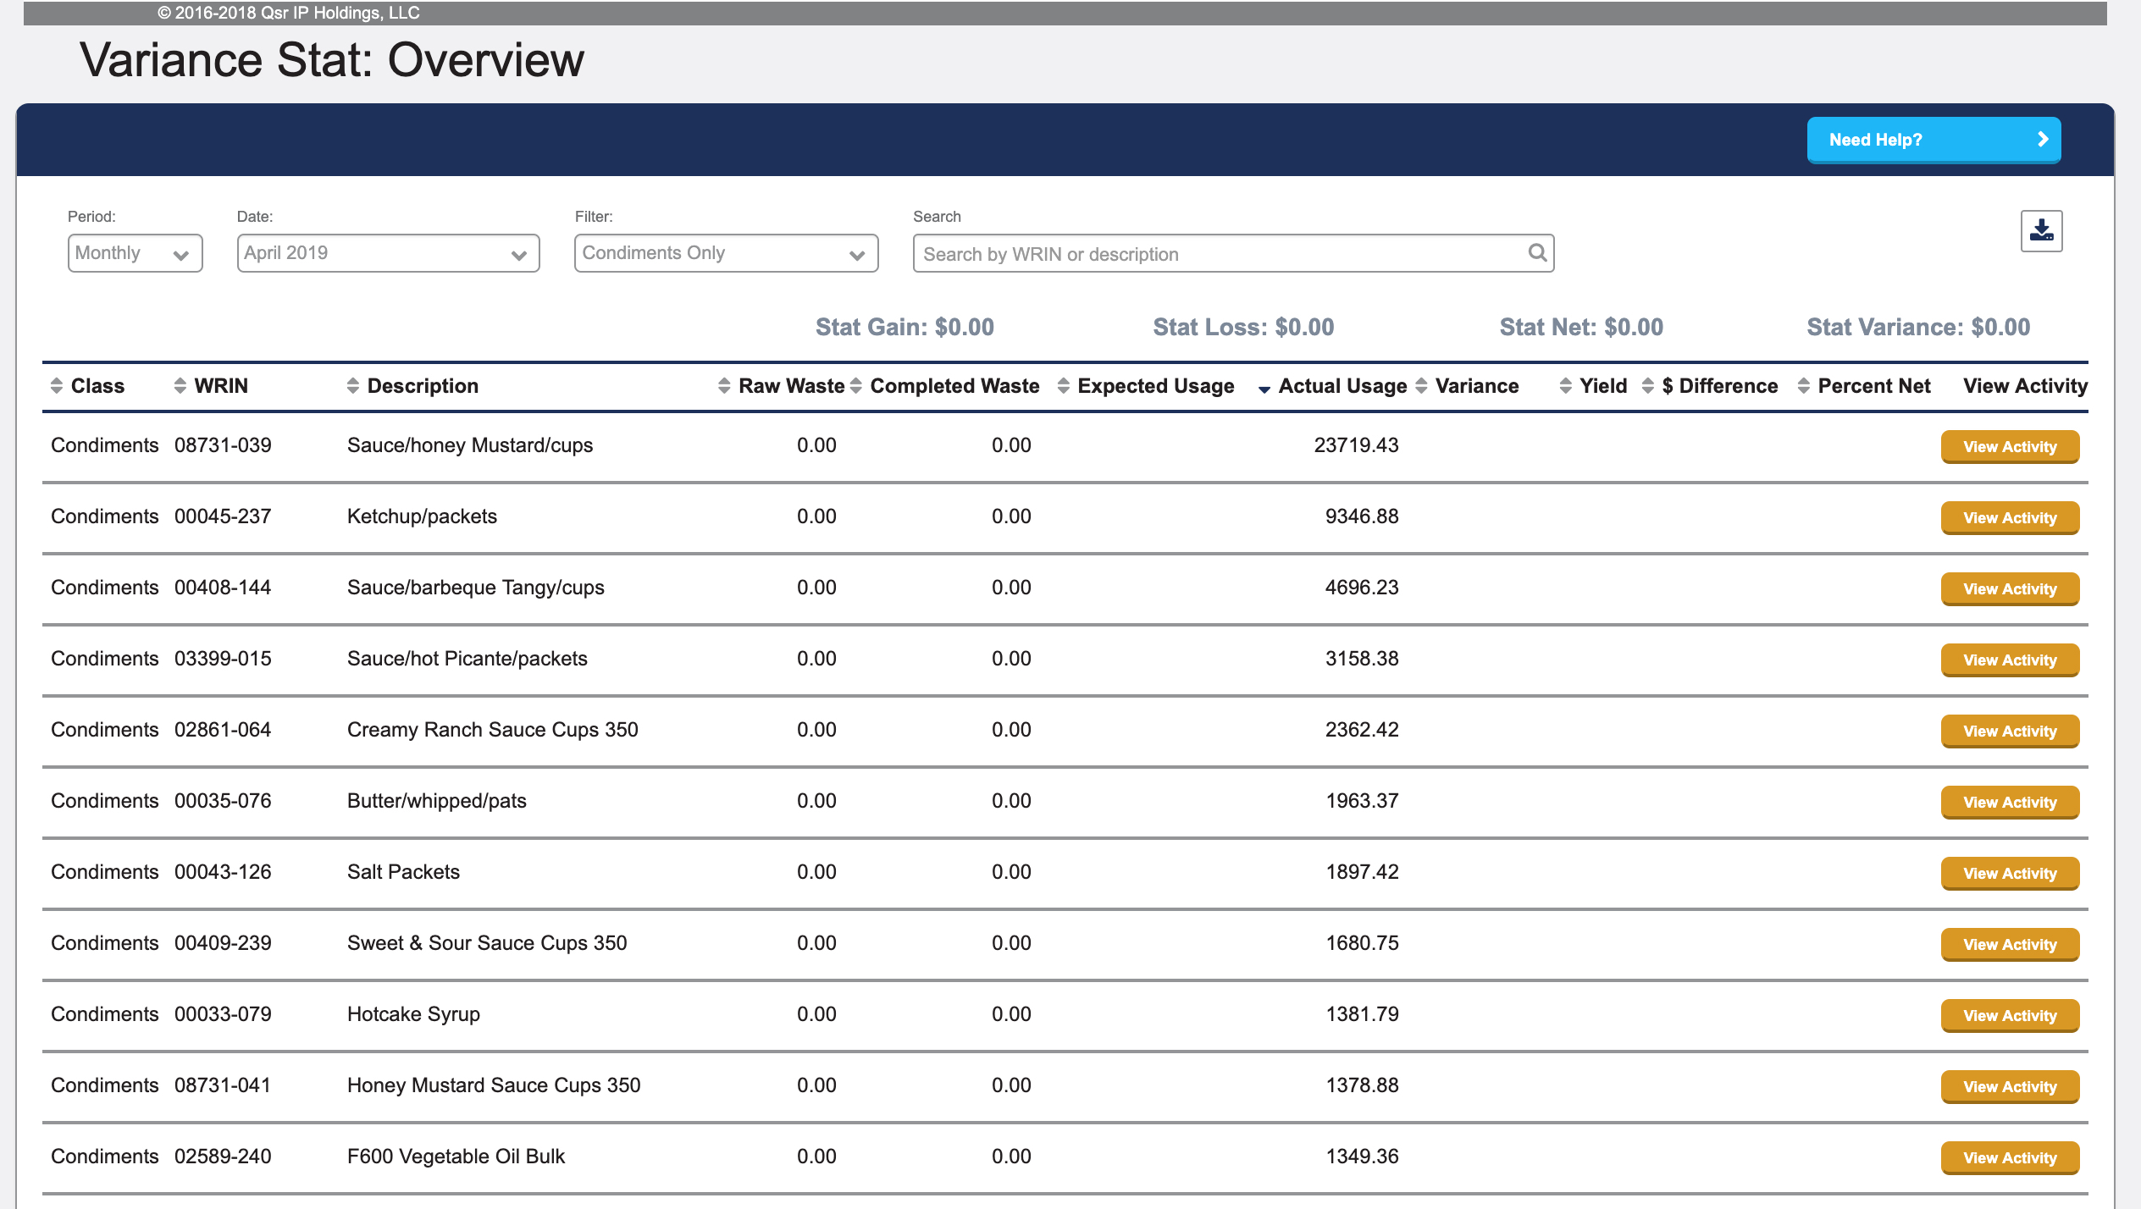
How do I recognize high condiment usage?
Sort
Notes:
When you click on the link you get a condiment stat report. While this does not show expected usage like recipe based items we can still get a lot of information from the screen.
Question: What is the condiment most restaurants use the most? (Note many people will answer Oil, which is the most expensive) Ketchup packets are usually the highest quantity.
In this restaurants case, when you sorted by actual usage, it showed Honey Mustard cups as the highest, and by a significant amount, more than 23,000.
To see this detail let’s click on View Activity

Slide 59
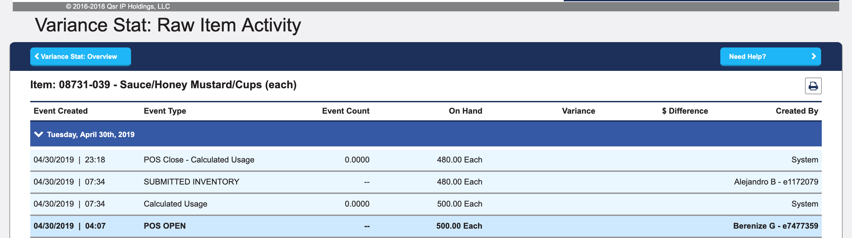
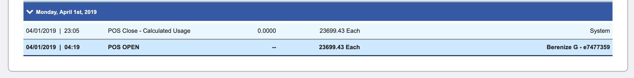
Incorrect inventory shown over time.
Notes:
This picture is from the Raw Item Activity but edited to include the start and end of the month together, this tells the story from the beginning to the end of the month.
They started with their error of 23,699 in the beginning of April. As a matter of fact they missed that in March their condiments had dropped to just over 1%.
During the end of month for April they got the corrected inventory, and ended the month with 480.
This meant that they told the system they used 23,000 honey mustard cups.
1 cup is 0.067 cents times 23,000 equals $1,541 which will lower the condiment costs to below their target for the month.
These are reasons why we should evaluate the end of month data before you are locked out of editing.

Slide 60
Questions?

Slide 61
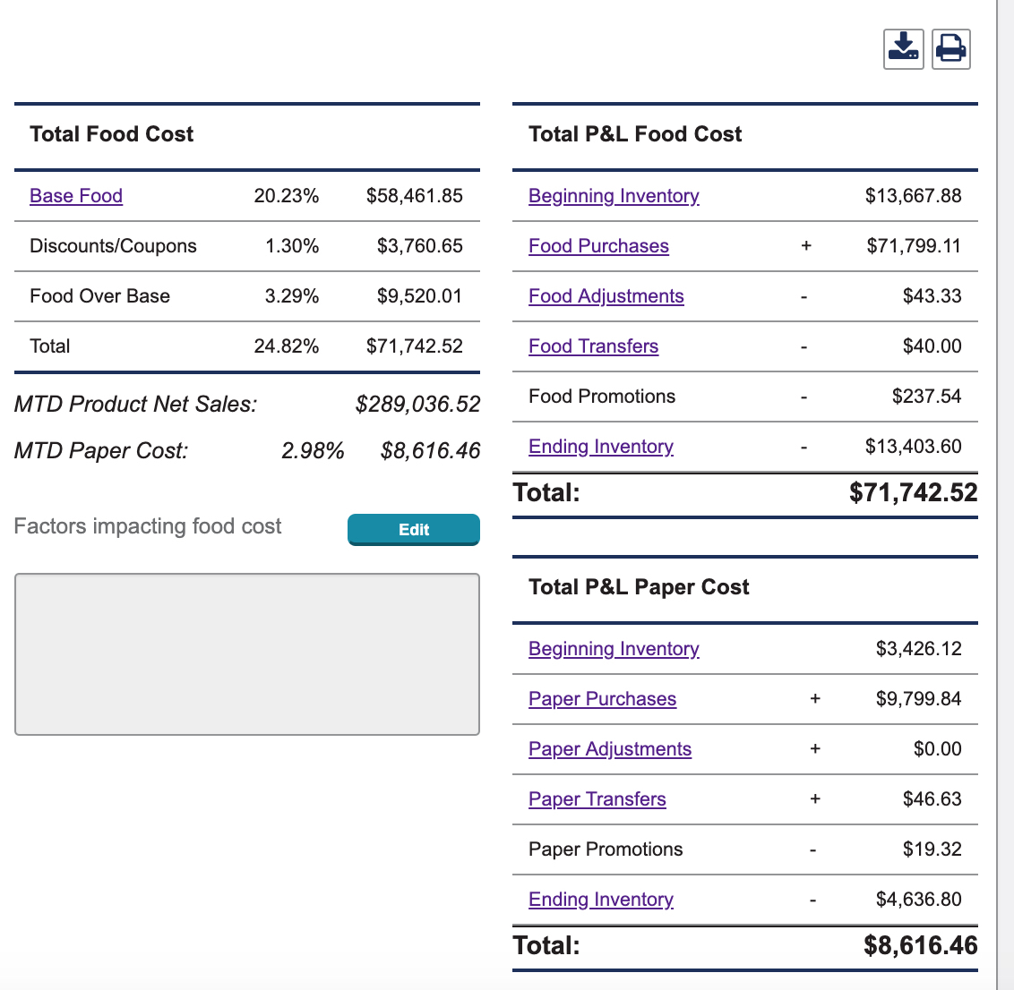
FOB P&L
Notes:
Let’s review the P&L side of the equation. It starts with Inventory, which we know also impacts the stat loss as well.
Check the on-hand inventory report for items that have not been counted and submitted at least once in the month. This is even more important for items that show new in parenthesis as part of the name. Those new items then have a verified starting inventory.
For Purchases or Adjustments, Truck managers review the incoming purchases and submit them to inventory right away. They compare the invoices to the information from the driver to confirm the invoices and purchases match. By doing this regularly, you are avoiding or minimizing stat difference, and making sure they get what they paid for.
Transfers must be approved in a timely basis by the “In” restaurant. Review to make sure they are accurate and timely.
Food promotion is the cost of any manual or electronic promo
Base food is the cost of serving the customers. It is the items served at their cost times the calculated price of the recipe. Items on the stat without an expected usage are not included in the base food.
Discounts and coupons are the calculated food cost associated with POS auto-bundle and with mobile offers.

Slide 62
On-the-Floor to impact food cost
  For each top FOB difference / Stat difference
  Raw Product handling
  Thaw / Cabinet Production Control
  Crew Food Assembly Procedures
  Crew Condiment Procedures
  Vegetable Oil maintenance
  Crew Register & Cash Procedures
  Equipment Maintenance
  Communication & Recognition
Notes:
As you review your FOB, and especially the stat, you need to take that information and ask questions like these
“What are the raw product handling and thaw and UHC cabinet procedures for this product? Are the crew following them?””
“What are the crew assembly procedures for this product? Are the crew following them?”
These are all kitchen processes that you need to follow op on the floor
Then we get into condiments and the crew procedures for condiments as well as the maintenance of the oil in the fryers
For the service area, just as we spoke earlier; are we taking action during drawer counts and cash management to assure accurate POS use
Next is the equipment maintenance, for any item at the top of the list check that the machine is functioning properly
For anything that you find, if it is product or equipment or procedures, document and communicate it to all and offer recognition
In a restaurant that does $230,000 per month, they will spend $60,000 on food. If we could get an improvement of just ½ of 1% that would save us $1,100 a month. But how do we find $1,100 out of $60,000 when we are talking about products that are cost less than $1. You must break it down into smaller parts. You can’t eat an elephant in one bite. You must narrow your focus to the smallest part that you can improve. Remember, just printing reports will NEVER improve food cost. You must take action on the facts that you gather.

Slide 63
Example for Fries
  Raw Product handling
    Handle gently
    Rotate stock out
    Don’t stack more than 6 high
  Thaw / Cabinet Production Control
    70 bags used per day (12 cases)
    Follow eProd Monitor
  Crew Food Assembly Procedures
    Hold carton front & back, don’t squeeze
  Crew Condiment Procedures
    Ask customer “…how many catsup packets do you want…”
  Vegetable Oil maintenance
    Skim vats hourly
    Top off during startup
  Crew Register & Cash Procedures
  Equipment Maintenance
  Communication & Recognition
Notes:
As you review your FOB, and especially the stat, you need to take that information and ask questions like these
“What are the raw product handling and thaw and UHC cabinet procedures for this product? Are the crew following them?””
“What are the crew assembly procedures for this product? Are the crew following them?”
These are all kitchen processes that you need to follow op on the floor
Then we get into condiments and the crew procedures for condiments as well as the maintenance of the oil in the fryers
For the service area, just as we spoke earlier; are we taking action during drawer counts and cash management to assure accurate POS use
Next is the equipment maintenance, for any item at the top of the list check that the machine is functioning properly
For anything that you find, if it is product or equipment or procedures, document and communicate it to all and offer recognition
In a restaurant that does $230,000 per month, they will spend $60,000 on food. If we could get an improvement of just ½ of 1% that would save us $1,100 a month. But how do we find $1,100 out of $60,000 when we are talking about products that are cost less than $1. You must break it down into smaller parts. You can’t eat an elephant in one bite. You must narrow your focus to the smallest part that you can improve. Remember, just printing reports will NEVER improve food cost. You must take action on the facts that you gather.

Slide 64
Owner Operator / Supervisor responsibilities
Determine Food Cost targets / projections
  Communicated and set after the 20th for the next month
Determine Daily / Weekly lists to inventory
  Daily 5 items, Weekly Refrigerator & Freezer (~60)
  Update Daily list as items improve
Follow-up on action plans
  Every crew person should know
Follow-up on “errors” in inventory or waste
  Prevent counting issues before they become major
Follow-up on EOM process and goals
Notes:
As an OO / mid-manager you have to set direction for the restaurant
You should collaborate with them on food cost targets, are they part of your bonus
What and when should inventory occur
Just running a stat doesn’t fix food cost, must create an action plan, example coming up
Review inventory for errors
At EOM review what worked and did not work

Slide 65
Questions?
Thank you michael.lewis@qsrsoft.com
630-320-0953 (text)

